Slide 1
Attackboard: A Novel Dependency-Aware Traffic Generator for Exploring NoC Design Space
Yoshi Shih-Chieh Huang, June 5, 2012
Yu-Chi Chang
Tsung-Chan Tsai
Yuan-Ying Chang
Chung-Ta King
Parallel And Distributed System Lab (PADS)
National Tsing Hua University, Hsinchu, Taiwan
Notes:
Good afternoon. My name is Yoshi, from Taiwan National Tsing Hua University. It’s my pleasure to present our research work “Attackboard”, which is a novel dependency-aware traffic generator for NoC design spsace exploration.

Slide 2
Problem Domain
2
We want to use trace-driven simulation to explore network-on-chip (NoC) performance for message-passing many-core architecture
Traces that record only send/receive events:
Simple and fast ☺
Lacks information about interaction between NoC and PEs ☹
Unable to reflect the effects of changes in design space ☹
Storage space overhead (in terms of gigabytes) ☹
Recent dependency-aware traces: [1][2]
Packet dependencies are embedded in traces ☺
Packet injections can be adjusted based on dependencies when facing different NoC configurations ☺
Trace logs are very complicated and require much more space ☹☹
Traces with packet dependencies improve accuracy but require more storage space!
Notes:
First of all, our target platform is a message-passing many-core architecture. Here we discuss trace-driven simulation rather than full-system simulation due to several considerations, especially the simulation speed.
So what’s the advantages and disadvantages of trace-driven simulation? It is simple and fast, widely used by many research works. But it lacks the information of the interaction between NoC and processing elements, so many changes cannot be reflected by trace-driven simulator. For example, if we increase the speed of processing elements, the trace-driven simulator usually cannot reflect the changes . And the last one is, they are usually large logs, in terms of gigabytes.
For tackling the problem of inaccuracy, recent works have done “dependency-aware” traces. The dependency, aka causality, are embedded into the trace logs. While injecting a packet, the packets before and after the injecting one are considered. As a result, it can improve the accuracy of trace-driven simulation. However, the causalities are usually complicated, and it makes the trace logs larger.
In summary, traces with packet dependencies improve accuracy, but require more storage spsace!

Slide 3
The BIG Problem Is: Size!
3
How to reduce size of dependency-aware traces while maintaining its accuracy?
Lossless compression, e.g., Gzip? → not enough
Key insight:
Each PE has its own BIG trace for NoC operations
Each BIG trace is actually a log of the execution of the corresponding State Machine
10 KB codes may result in 1GB traces!
…
…….
…….
…
…….
….
…….
…
……
….
…...
…
….
S₁
…
S₂
S₁
S_{n}
…
S₂
S₁
S_{n}
…
S₂
S_{n}
Notes:
The BIG problem is: size. So how to reduce the size of traces while maintaining accuracy?
Usually general compression is used, such as gzip. Certainly, it is not a good solution.
Our key insight is that: (1) Each processing element has its own big trace for NoC operations.
(2) Each big trace is actually a log of the execution of the corresponding State Machine.
The left part shows the trace logs, and the right part shows the state machines. Certainly, there are relationships between them.
For example, 10kb codes may cause more than 1GB traces.
10kb for the state machines, and 1GB for the trace logs.

Slide 4
Rebuild the State Machines
4
What if we can rebuild the interacting state machines from the traces…?
We don’t have to record the huge traces but only need to generate them at runtime!
How to do?
Intuitive idea: find repetitive patterns in traces and fold them
Difficulties:
May not be matched exactly
May be discrete and fragmented in traces
Need to find patterns across the traces resulted by different PEs
Notes:
So now the problem is, we are trying to rebuild the state machine from the resulting traces, not from the source codes.
We found that we can use simple and small tables to represent the state machines. That is Attackboard.
There are several possible ways to capture the characteristics from the traces. Intuitively, finding the repetitive patterns and folding them are the simplest way. However, it is difficult because of the following considerations:
The patterns may not be exactly matched.
The repetitive patterns may be discrete and fragmented in trace logs
To find the repetitive patterns, we need to traverse the independent trace logs across the processing elements.

Slide 5
Rebuild the State Machines (cont’d)
5
State transitions in state machines are often triggered by arrivals of packets
Leverage packet dep. information in traces
Forget about time sequencing in traces
How long to wait before start detecting receiving pattern? → interval-based
Interval I for capturing receiving patterns
Captured results are attackboards
Interval I’ for reproducing traffic
For driving the attackboards
PE_{j}
I
Notes:
Our key observation is that, state transitions in state machine are usually triggered by the arrivals of packets.
So we want to leverage packet dependency information in traces. Note that we focus on patterns of received packets.
Our proposed solution is an interval-based solution, which periodically capture the traffic patterns. After collection the patterns, we can reproduce the traffic then.
Here, I is the interval to capture patterns, and I’ is the interval to reproduce. Selecting I and I’ is tricky, and the details can be found in the paper.

Slide 6
Data Structure of an Attackboard
6
Each PE has an attackboard
An injection Y is allowed if the necessary conditions are satisfied
Necessary conditions = predecessors = must receive packets from X
necessary conditions
Inject if satisfied
Requires pkt from 1? | Requires pkt from 2? | Requires pkt from 3? | … | Requires pkt from X? | Inject to …
Yes | Yes | No |  |  | Dest. Y
…

Slide 7
Attackboard Traffic Generator
7
Rebuild the state machines as attackboards
Use packet arrival patterns in traces to rebuild the state machine
Space complexity:
O(execution time) → O(# of patterns)
Compact the states
Merge duplicated patterns
Drive the state machines, i.e., attackboard
Inject traffic based on the rebuilt machine
Notes:
To summarize, we have three key ideas. Idea 1, we want to transform the time-driven logs into pattern-driven tables.
Since the reason of causing large files are time, for example, cycle-accurate logs are usually huge files, so Attackboard forgets the time sequencing in traces, and uses packet arrival patterns to drive sequencing of states, and do the corresponding injections.
After this, idea 2 is for minimizing the table sizes. Once all the trace logs are transformed into table with patterns, the following issue is how to match the patterns in the table. In the following slides, we use an illustration to show the three key ideas.

Slide 8
An Illustration (Viewpoint of PE 4)
8
Parallel Program Execution
PE 1
PE 2
PE 3
PE 4
Attackboard entries of PE 4
Execution flow of parallel program
Packets Dependencies |  |  |  | Injection Info.
1 | 1 | 0 | 0 | (3, flit counts)
recv 1
Interval I
recv 2
send 1
Packets Dependencies |  |  |  | Injection Info.
1 | 1 | 0 | 0 | (3, flit counts)
How long to wait before start detecting receiving pattern?
Interval I decides the pattern!
Packets Dependencies |  |  |  | Injection Info.
1 | 1 | 0 | 0 | (3, flit counts)
recv 3
Interval I
recv 4
send 2
recv 5
Packets Dependencies |  |  |  | Injection Info.
1 | 1 | 1 | 0 | (2, flit counts)
recv 5
Interval I
recv 6
recv 6
Interval I
recv 7
recv 7
send 3
Compress the entries with the same packet dependencies
Merge duplicated entries
send 3
Notes:
Here is the illustration. Let’s use the view point of PE4. Assuming there are four PEs, and PE 1 and 2 send packets to PE four subsequently. By looking behind an interval I, we conclude that send 1 (payload = 2 flits) from core 4 to core 3, is caused by the previous 2 sends. The corresponding attackboard is here. As you can see, each column stands for the “necessary condition” for an injection. So the first two columns, standing for core 1 and 2 are marked as 1.
Similarly, we can derive another attackboard, like this.
Repeat this process, we can get many attackboards, here we show 3 different attackboards. One intuitive problem is: these attackboards may be similar, or even totally the same. So the following process is try to merge those attackboards which have similar column entries.
Certainly, while merging the attackboards, some conditions muse be satisfied. The details are not shown in this slides.

Slide 9
Driving the Attackboards!
9
Traffic generation with Attackboard
Router receives stats are cleared every I’ interval
What if no exact match in I’?
Match the entry which has the highest similarity
Similar to bloom filter (deny for sure, allow with high confidence)
Attackboard Traffic Generator (ATG)
ATG
Attackboard of PE4
Match!
1 | 1 | 0 | 0 | traffic
current receive source
Inject!
Router
router receive status of PE4
0 | 0 | 0 | 0
1 | 0 | 0 | 0
1 | 1 | 0 | 0
NoC
Design details are left in the poster.
You are welcome to take a look!
Notes:
Here we show the process of generating traffic with the help of an attackboard. This simple example has only four columns (predecessors).
First, the router receives a packet from node 1, so the first column of the “router receive status” is marked as 1.
After a while, the router receives another packet from node 2, so the second column of the router receive status is also marked as 1.
As you can see, the router receive status now is the same with the attackboard, so it strikes a match. The corresponding traffic will be injected by this router.
After previous and this slide, you should know that how Attackboard works. Of course, there are still some problems to solve.
One important problem is to select the suitable I and I’. As we mentioned before, the dependency of an injection may not be totally captured with an interval I.
So our third key idea is for solving this problem. We use the idea of bloom filter.
Which may inject the entry which has the highest similarity in the attackboard. The design details are left in our poster. You are welcome to join our discussion.

Slide 10
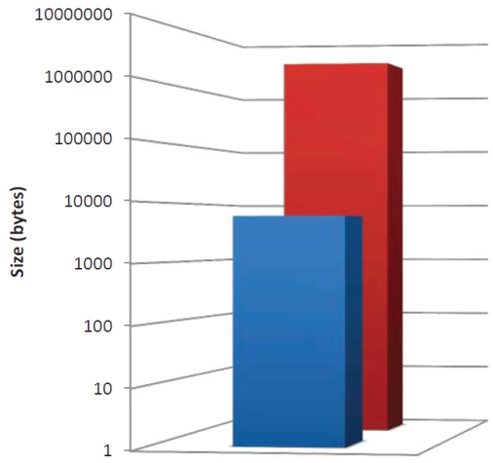
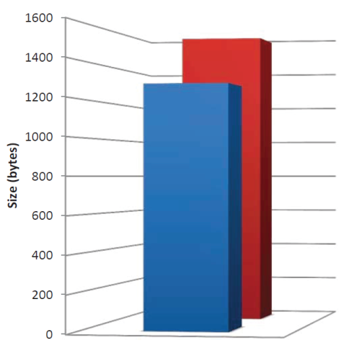
Space Overhead and Accuracy
10
Simulation Platform
Processor element | Tilera TILE64 ¹
Processor frequency | 700 Mhz
Simulated topology | 4×4 mesh network
Routing algorithm | Dimension-order
Bandwidth | 1 flit/cycle per port
Benchmark | Intel MPI Benchmarks Parallel Object Detection
Storage Space Overhead
IMB-Bcast
POD (2 frames)
20% storage space can be reduced in computation-intensive benchmark!
Storage space can be greatly reduced!
Parallel Object Detection
IMB-Bcast
In this case, I does not have much impact compared with POD.
I and I’ should be properly selected to give accurate results
¹ S.Bell et al.[ISSCC 2008]
Notes:
In this slide, we show some experiment results. Our main considerations are space overhead and accuracy.
We use Tilera’s TILE64, the settings are shown in this Table. We simulate a 4x4 mesh network, and use two benchmark programs.
One is Broadcast in Intel MPI benchmark, which has simple behaviors. The other one is parallel object detection, relatively complicated communication causalities.
First let’s see the IMB, the required space by Attackboard is more than 100x smaller than original traces.
The improvement in parallel object detection is not that much, because the execution time is quite short and the traffic patterns are not obvious.
Second, let’s see the accuracy, here two parameters are I and I’. The former is the interval for capturing dependencies, and the latter is the interval for generating injections.
While the capturing interval is too small, the dependencies are hard to be observed, and the accuracy is quite low. While the interval increases, the traffic generated by Attackboard is quite similar to the original accuracy.
In IMB-Broadcast, the selection of I and I’ are not that important. The accuracy ranges from 0.8 to 1.1. Very close to original accuracy. This is because that the dependency is quite simple in broadcast, and thus easier to be captured.
However, selecting good I and I’ are important and tricky, which behaves as two magic numbers to compress the trace log. Or, in other words, two magic numbers to rebuild the behaviors of original state machines.
In our following work, we have emphasized this problem and the values of I and I’ can be automatically selected.

Slide 11
Conclusion & Future Works
11
Attackboard not only compresses the NoC traces, but generates them at runtime
Key ideas:
Programs → raw trace logs → use arrival patterns to rebuild state machine (as Attackboards) → rebuild trace logs
Benefits
Strikes a good tradeoff between accuracy and space overhead
Limitations
Currently only for message-passing programs
Only suitable for injections with strong dependencies
Future works
Take the computation time before an injection into consideration
Make the tricky parameters (I and I’) disappeared

Slide 12
Thank You!
To learn more, please come to my poster!

Slide 13
Selected References
Netrace: dependency-driven trace-based network-on-chip simulation.
Joel Hestness, Boris Grot, and Stephen W. Keckler. 2010.
In Proceedings of the Third International Workshop on Network on Chip Architectures (NoCArc '10)
Inferring packet dependencies to improve trace based simulation of on-chip networks.
Christopher Nitta, Matthew Farrens, Kevin Macdonald, and Venkatesh Akella. 2011.
In Proceedings of the Fifth ACM/IEEE International Symposium on Networks-on-Chip (NOCS '11)

Slide 14
Backup: More Frames in POD
Trace logs | O(execution time)
Attackboard | O(# of patterns)

