Slide 1
CS4101 Introduction to Embedded Systems
Lab 8: NuMaker TRIO
Prof. Chung-Ta King
Department of Computer Science
National Tsing Hua University, Taiwan

Slide 2
Introduction
In this lab, we will learn
  How to set up and use GPIO of NuMaker TRIO?
  How to use timer and interrupt in NuMaker TRIO?
  How to set up the programming environment for NuMaker TRIO?

Slide 3
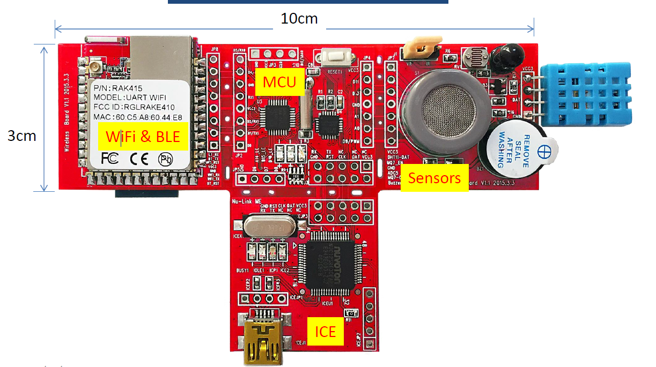
NuMaker TRIO
Based on Nuvoton Cortex®-M0 NANO102 MCU
  Cortex-M0: 32-bit ARMv6 RISC processor
Run up to 32Mhz, 32KB Flash ROM, 8KB SRAM

Slide 4
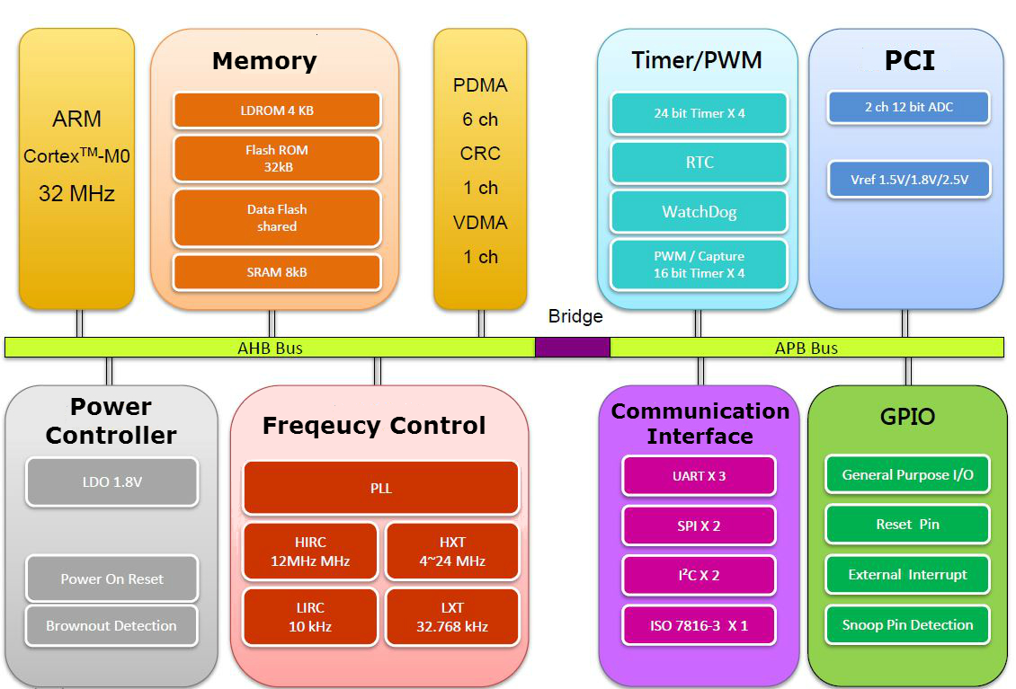
NANO102 MCU

Slide 5
Sources for Clock Controller
32768Hz external low-speed crystal oscillator (LXT)
4~ 24 MHz external high-speed crystal oscillator (HXT)
12/16 MHz internal high-speed RC oscillator (HIRC)
10 kHz internal low-speed RC oscillator (LIRC)
Programmable PLL FOUT (PLL source can be selected from HXT or HIRC)
//Define Clock source #define MCU_CLOCK_SOURCE #define MCU_CLOCK_SOURCE_HIRC // HXT, LXT, HIRC, LIRC #define MCU_CLOCK_SOURCE_LXT #define MCU_CLOCK_FREQUENCY 32000000 //Hz range 16MHZ~32MHZ

Slide 6
GPIO Set Mode
Library/StdDriver/src/gpio.c
GPIO set mode: GPIO_SetMode(PA, BIT12, GPIO_PMD_OUTPUT);
GPIO port:
  NANO102 = PA, PB, PC, PD, PE, PF
Pin mask = BIT0~15
  Single or multiple pins of specified GPIO port
I/O modes:
  GPIO_PMD_INPUT: input only mode
  GPIO_PMD_OUTPUT: push-pull output mode
  GPIO_PMD_OPEN_DRAIN: open-drain output mode
To write to pin 12 of port PA: PA12 = 0;
To read from pin 12 of port PA: if (PA12 !=0) { }
Notes:
* @param[in] gpio GPIO port. It could be \ref PA, \ref PB, \ref PC, \ref PD, \ref PE or \ref PF.
* @param[in] u32PinMask The single or multiple pins of specified GPIO port.
* @param[in] u32Mode Operation mode. \ref GPIO_PMD_INPUT, \ref GPIO_PMD_OUTPUT, \ref GPIO_PMD_OPEN_DRAIN
*
* @return None
*
* @details This function is used to set specified GPIO operation mode.

Slide 7
Sample Code
#include <stdio.h> #include "Nano1X2Series.h" #include "MCU_init.h" #include "SYS_init.h" void Init_RGBLED(void) { GPIO_SetMode(PB, BIT15, GPIO_PMD_OUTPUT); GPIO_SetMode(PA, BIT14, GPIO_PMD_OUTPUT); GPIO_SetMode(PD, BIT10, GPIO_PMD_OUTPUT); PB15=1; // red LED off PA14=1; // green LED off PD10=1; // blue LED off }

Slide 8
Sample Code
int32_t main() { SYS_Init(); Init_RGBLED(); while(1) { PB15=0; // Red LED on CLK_SysTickDelay(200000); PB15=1; // Red LED off CLK_SysTickDelay(200000); PA14=0; // Green LED on CLK_SysTickDelay(200000); PA14=1; // Green LED off CLK_SysTickDelay(200000); PD10=0; // Blue LED on CLK_SysTickDelay(200000); PD10=1; // Blue LED off CLK_SysTickDelay(200000); } }

Slide 9
Outline
GPIO of NuMaker TRIO
Timer and interrupt in NuMaker TRIO
Programming environment for NuMaker TRIO

Slide 10
Timer
Four timers: TIMER0, TIMER1, TIMER2, TIMER3
Four operating modes:
  One-shot mode
  Periodic mode
  Output Toggle mode
  Continuous mode
Each timer is equipped with an 8-bit pre-scale counter, a 24-bit up-counter, a 24-bit compare register and an interrupt request signal

Slide 11
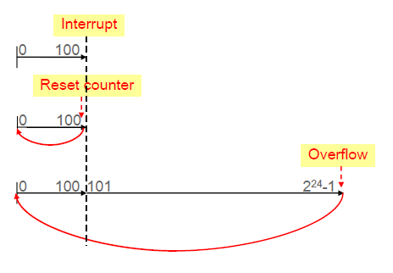
Timer Operating Modes
Example: Timer Compare Register (TCMPR) = 100
One-Shot
Periodic/
Toggle
Continuous
Notes:
TCMPR= timer compare register

Slide 12
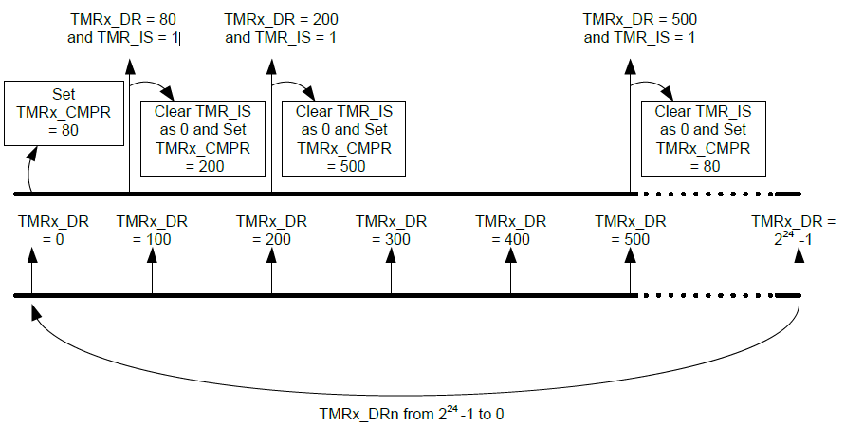
Example Using Continuous Mode
TMR_CMPR (timer compare register) TMR_DR (timing counter value)
TMR_IS (timer interrupt status)
Notes:
Continuous mode 就是當timer數到TMR_CMPR的時候，會發生interrupt，但interrupt結束後，counter不會歸0，而是往上數直到overflow (2^24-1)
如這張圖，當TMR_DR數到TMR_CMPR ( 80 ) 的時候，會發生interrupt，並把TMR_IS設為 1，
在這個interrupt我們可以更改TMR_CMPR的值 (200)，並把TMR_IS設為 0 ，這樣counter繼續數地的時候，到200又會發生一次interrupt。

Slide 13
MCU_init.h for Timer
//Define MCU Interfaces #define MCU_INTERFACE_TMR1 #define TMR1_CLOCK_SOURCE_HIRC // HXT, LXT, LIRC, EXT, HCLK #define TMR1_CLOCK_DIVIDER 1 #define TMR1_OPERATING_MODE TIMER_PERIODIC_MODE // ONESHOT, PERIODIC, TOGGLE, CONTINUOUS #define TMR1_OPERATING_FREQ 100 //Hz

Slide 14
Interrupt Controller
Nested Vectored Interrupt Controller (NVIC)
  Support 32 (IRQ[31:0]) discrete interrupts with 4 levels of priority
  When an interrupt is accepted, the starting address of the interrupt service routine (ISR) is fetched from a vector table in memory
  While the starting address is fetched, NVIC will also automatically save processor state to the stack
  At the end of the ISR, the NVIC will restore the saved registers from stack and resume the normal execution

Slide 15
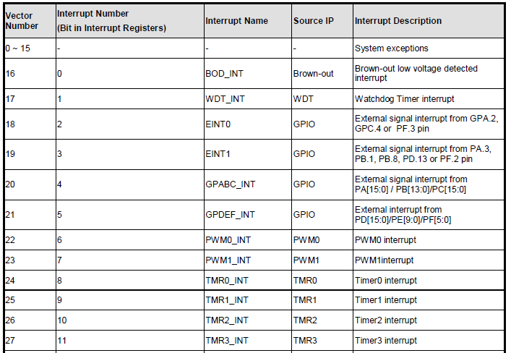
System Interrupt Map

Slide 16
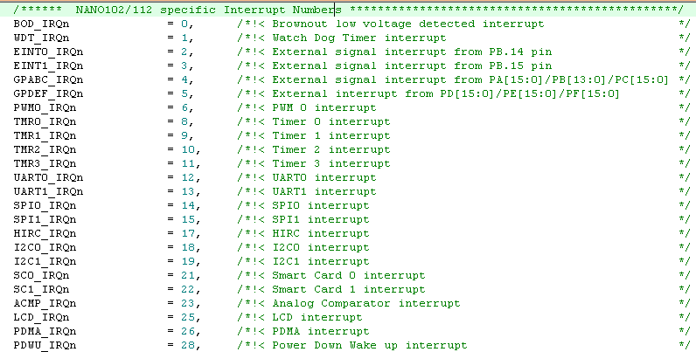
NVIC Interrupt Variable

Slide 17
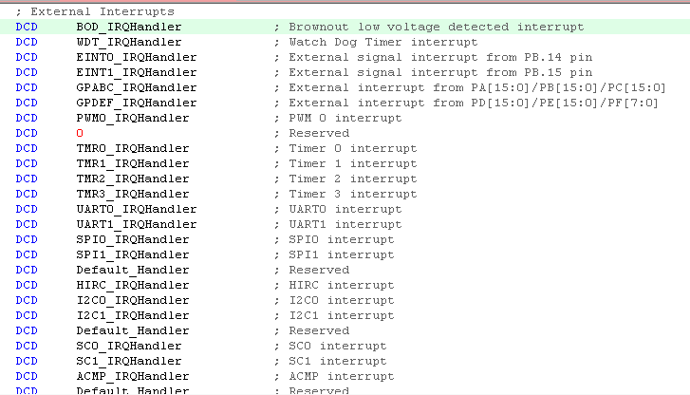
Interrupt Handler Function Name

Slide 18
Interrupt Sample Code
#include <stdio.h> #include "Nano1X2Series.h" #include "MCU_init.h" #include "SYS_init.h" volatile uint32_t timer_count =0; void Init_Timer1(void) { TIMER_Open(TIMER1,TMR1_OPERATING_MODE,TMR1_OPERATING_FREQ); TIMER_EnableInt(TIMER1); //enable timer interrupt NVIC_EnableIRQ(TMR1_IRQn); TIMER_Start(TIMER1); } int32_t main() { SYS_Init(); Init_Timer1(); while(1) { } }
Notes:
它有指定發生interrupt的時候要去哪個 handler 的 function name，除了enable timer本身的interrupt，同時也要enable在NVIC裡對應位置的interrupt

Slide 19
Interrupt Sample Code
void TMR1_IRQHandler(void) { timer_count++; printf("Timer1 = %d, %d\n", timer_count,TIMER1->CMPR); TIMER_ClearIntFlag(TIMER1); // clear timer interrupt flag }

Slide 20
Outline
GPIO of NuMaker TRIO
Timer and interrupt in NuMaker TRIO
Programming environment for NuMaker TRIO

Slide 21
Software Development Kit (SDK)
ARM Keil Microcontroller Development Kit (MDK)
  IDE, C/C++ compiler, debugger for ARM Cortex-M
  https://www.keil.com/demo/eval/arm.htm
  Register and download MDK517.exe
NuLink Driver
  Nu-Link_Keil_Driver_V1.30.6491.zip
  Driver to link PC to NuMaker TRIO board through USB
Board Support Package (BSP): MCU device driver and sample code
  Nano102_BSPv3.02_EDU

Slide 22
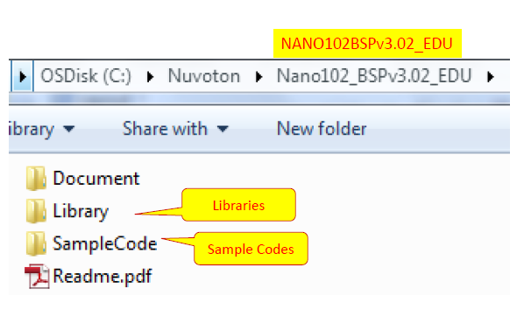
NANO102 BSP

Slide 23
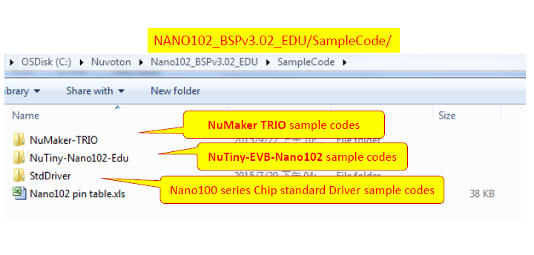
SampleCode Folder

Slide 24
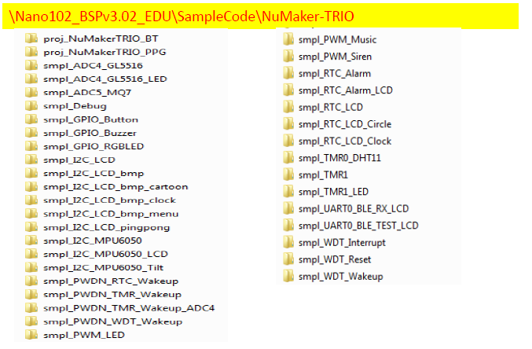
NuMaker TRIO Folder
Use Smpl_Debug as the template

Slide 25
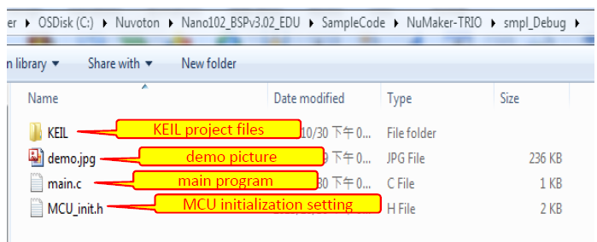
Smpl_Debug Folder

Slide 26
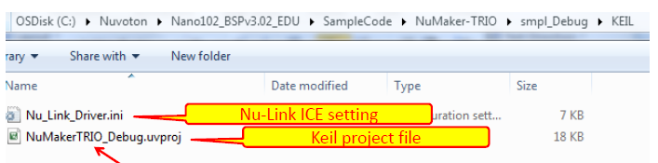
Keil Folder
Double click on .uvproj file to open a Keil project

Slide 27
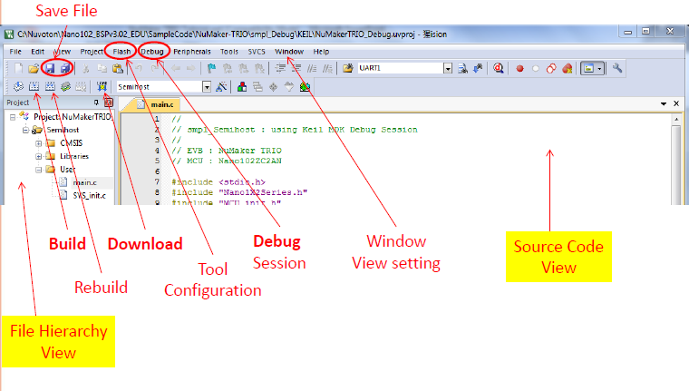
Keil MCU Development Environment

Slide 28
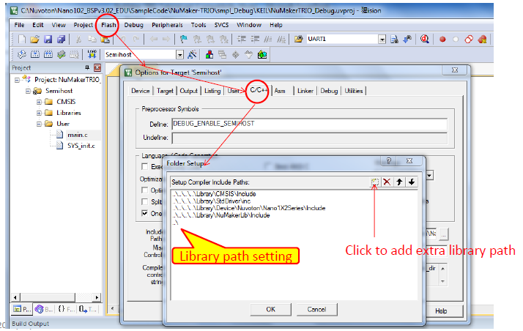
Keil MDK Configuration

Slide 29
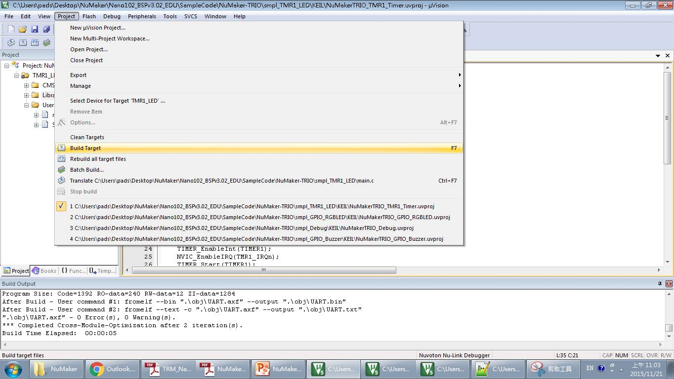
Build and Execute
1. Build your project

Slide 30
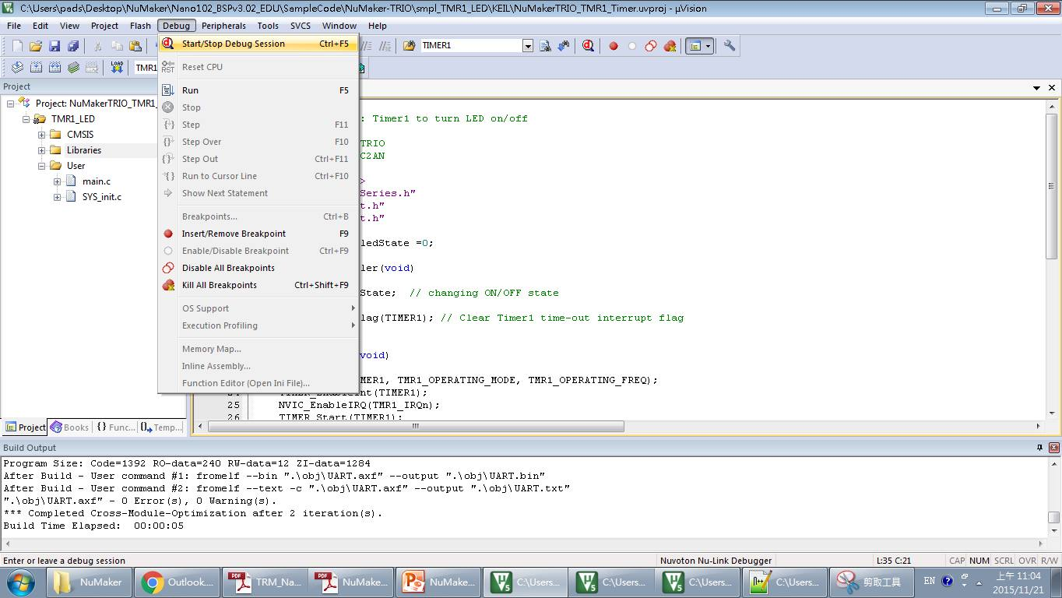
Build and Execute
2. Change to debug mode
3. Run your project

Slide 31
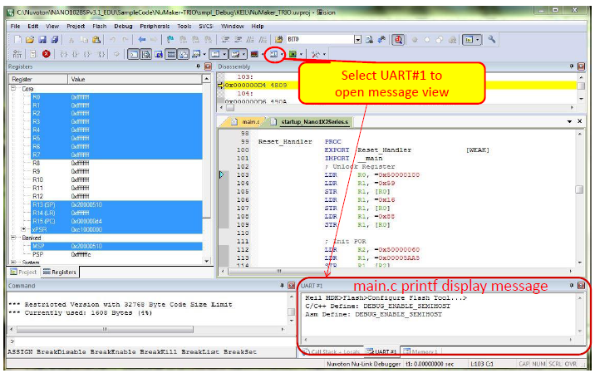
Debug Session

Slide 32
Lab
Basic 1:
  Flash both red and green LEDs at 1 Hz. The red LED should be on for 0.7 sec and off for 0.3 sec, which is controlled by polling TIMER1 sourced by HIRC. The green LED should be on for 0.3 sec and off for 0.7 sec, which is controlled by polling TIMER0 sourced by LIRC, the divider of TIMER0 should be 2.
  Hint: TIMER_Open() will start counting compare register (TIMERX->CMPR) according to TMRX_OPERATING_FREQ in MCU_init.h (X=0,1,2,3). You can trace the function or print the variable to find the relationship between TMR1_OPERATING_FREQ and TIMERX->CMPR. Use TIMERX->CMPR to change the value of compare register.

Slide 33
Lab
Basic 2:
  The traffic light will change to the green light when there is an ambulance passing.
  Let the blue LED represent the yellow traffic light, and the buzzer indicates the passing of an ambulance.
  Normally the red LED is on for 3 sec, then the blue LED is on for 2 sec, then the green LED is on for 4 sec, and repeat.
  The buzzer will be turned on for 4 sec at 2 Hz (0.5 sec on and 0.5 sec off). The starting time is set randomly between 6 and 15 sec. During the 4 sec that the buzzer sounds, the traffic light will be turned to the green LED. After the 4 sec, the traffic light returns to normal.

