Slide 1
Introduction to JFC Swing
Written by
Adam Carmi

Slide 2
Agenda
About JFC and Swing
Pluggable Look and Feel
Swing Components
Borders
Layout Management
Events Handling

Slide 3
About JFC and Swing
JFC – JavaTM Foundation Classes
Encompass a group of features for constructing graphical user interfaces (GUI).
Implemented without any native code.
“Swing” is the codename of the project that developed the first JFC components (JFC 1.1¹).
The name “Swing” is frequently used to refer to new components and related API.
Initially released as an extension to JDK 1.1

Slide 4
About JFC and Swing (cont)
Swing features:
The Swing Components
Dialog, Tabbed pane, Buttons, File Chooser, ...
Pluggable Look and Feel
Accessibility API
Screen readers, Braille displays, ...
Java 2DTM API (Java 2 Platform only)
Drag and Drop (Java 2 Platform only)
Between Java applications and native applications.

Slide 5
Pluggable Look and Feel
Each picture shows the same program but with a different look and feel

Slide 6
Swing Components
Swing provides many standard GUI components such as buttons, lists, menus, and text areas, which you combine to create your program's GUI.
Swing provides containers such as windows and tool bars.
top level: frames, dialogs
intermediate level: panel, scroll pane, tabbed pane, ...
other Swing components: buttons, labels, ...
A visual index of Swing components

Slide 7
Containers
Descendents of the java.awt.Container class
Components that can contain other components.
Use a layout manager to position and size the components contained in them.
Components are added to a container using one of the various forms of its add method
Depending on which layout manager is used by the container
panel.add(component);

Slide 8
Top Level Containers
Every program that presents a Swing GUI contains at least one top-level container.
A Top level container provides the support that Swing components need to perform their painting and event-handling.
Swing provides three top-level containers:
JFrame (Main window)
JDialog (Secondary window)
JApplet (An applet display area within a browser window)

Slide 9
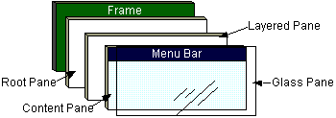
Top Level Containers (cont)
To appear on screen, every GUI component must be part of a containment hierarchy, with a top-level container as its root.
Each top-level container has a content pane that contains visible components in that top-level container’s GUI.
Don’t add a component directly to a top-level container.

Slide 10
JFrame
A frame implemented as an instance of the JFrame class, is a window that has decorations such as a border, a title and buttons for closing and iconifying the window.
The decorations on a frame are platform dependent.
Applications with a GUI typically use at least one frame.

Slide 11
Example 1
import javax.swing.*;
public class HelloWorldSwing {
public static void main(String[] args) {
JFrame frame = new JFrame("HelloWorldSwing");
final JLabel label = new JLabel("Hello World");
frame.getContentPane().add(label);
frame.setDefaultCloseOperation(JFrame.EXIT_ON_CLOSE);
frame.pack();
frame.setVisible(true);
}
}
pack() causes a window to be sized to fit the preferred size and layouts of its sub-components

Slide 12
Example 2
import javax.swing.*;
public class HelloWorldFrame extends JFrame {
public HelloWorldFrame() {
super(“HelloWorldSwing”);
final JLabel label = new JLabel("Hello World");
getContentPane().add(label);
setDefaultCloseOperation(JFrame.EXIT_ON_CLOSE);
pack();
setVisible(true);
}
public static void main(String[] args) {
HelloWorldFrame frame = new HelloWorldFrame();
}
}
In this example a custom frame is created

Slide 13
JDialog
Every dialog is dependent on a frame
Destroying a frame destroys all its dependent dialogs.
When the frame is iconified, its dependent dialogs disappear from the screen.
When the frame is deiconified, its dependent dialogs return to the screen.
A dialog can be modal. When a modal dialog is visible it blocks user input to all other windows in the program.

Slide 14
JDialog (cont)
To create custom dialogs, use the JDialog class directly (as in the previous examples).
Swing provides several standard dialogs
JProgressBar, JFileChooser, JColorChooser, ...
The JOptionPane class can be used to create simple modal dialogs
icons, title, text and buttons can be customized.

Slide 15
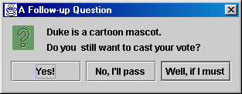
Example 3
Object[] options = {"Yes!", "No, I'll pass",
"Well, if I must"};
int n = JOptionPane.showOptionDialog(
frame, "Duke is a cartoon mascot. \n" +
"Do you still want to cast your vote?",
"A Follow-up Question",
JOptionPane.YES_NO_CANCEL_OPTION,
JOptionPane.QUESTION_MESSAGE,
null,
options,
options[2]);

Slide 16
JComponent
JComponent is the base class for all Swing components except top-level containers.
JLabel, JButton, JList, JPanel, JTable, ...
To use a component that inherits from JComponent, it must be placed in a containment hierarchy who’s base is a top-level container.

Slide 17
JComponent (cont)
The JComponent class provides the following (partial list):
Pluggable Look & Feel
Keystroke handling
Tooltip support
Accessibility
An infrastructure for painting
Support for borders.
All descendents of JComponent are also Containers
A JButton can contain text, icons etc.

Slide 18
Borders
Every JComponent can have one or more borders.
The class BorderFactory may be used to create standard borders
pane.setBorder(BorderFactory.
createLineBorder(Color.black));
Using a compound border, you can combine any two borders, which can themselves be compound borders
BorderFactory.createCompoundBorder(border1, border2);

Slide 19
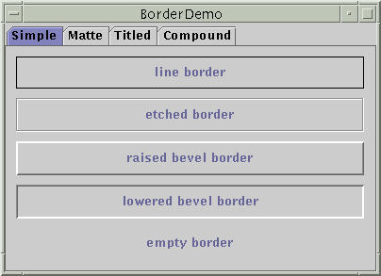
Simple Borders

Slide 20
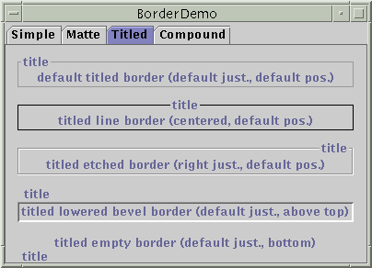
Titled Borders

Slide 21
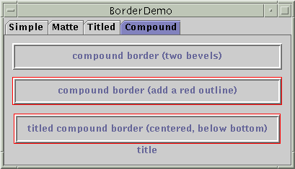
Compound Border

Slide 22
Intermediate Level Containers
Also known as panels or panes
Simplify the positioning of other components.
JPanel
Play a visible and interactive role in a program’s GUI
JScrollPane
JTabbedPane
A panel’s default layout manager is FlowLayout.
Other layout managers can easily be set
panel.setLayout(new BorderLayout());

Slide 23
Intermediate Level Containers (cont)
By default, panels don’t paint anything except for their background.
By default, panels are opaque.
An opaque panel can be set as a top-level container’s content pane.
transparent (non-opaque) panels draw no background.

Slide 24
Layout Management
The process of determining the size and position of components.
Layout management can be done using absolute positioning
Size and position of every component within the container must be specified.
Does not adjust well when the top-level container is resized.
Does not adjust well to differences between users and systems, such as font size.

Slide 25
Layout Management (cont)
Layout management is often performed using layout mangers
Components can provide size and position hints to layout managers, but layout managers have the final say on the size and position of those components.

Slide 26
Layout Management (cont)
Layout hints
Minimum, preferred and maximum size
X axis alignment, Y axis alignment
Customizing layout hints
Invoking setter methods: setMinimumSize, setAlignmentX, ...
Subclassing and overriding the getter methods: getMinimumSize, getAlignmentX, ...

Slide 27
Layout Management (cont)
The Java platform supplies five commonly used layout managers:
BorderLayout
BoxLayout
FlowLayout
GridLayout
GridBagLayout

Slide 28
Layout Management (cont)
When using the add method to put a component in a container, the container’s layout manager must be taken into account.
Relative position (BorderLayout)
panel.add(component, BorderLayout.CENTER);
Order of addition (BoxLayout, GridLayout, ...)
panel.add(component);

Slide 29
BorderLayout
Has five areas available to hold components
north, south, east, west and center
All extra space is placed in the center area
Only the center area is affected when the container is resized.
Default layout manager of content panes.

Slide 30
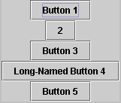
BoxLayout
Places components in a single row (left to right) or column (top to bottom).
Respects component’s maximum size and alignment hints.

Slide 31
FlowLayout
Places components from left to right, starting new rows if necessary.
Default LayoutManager of JPanel

Slide 32
GridLayout
Places components in a requested number of rows and columns.
Components are placed left-to-right and top-to-bottom.
Forces all components to be the same size
as wide as the widest component's preferred width
as high as the highest component’s preferred height

Slide 33
Layout Management (cont)
The following factors influence the amount of space between visible components in a container:
Layout manager
automatically, user specified, none
Invisible components
often used with BoxLayout
Empty borders
works best with components that have no default border such as panels and labels.

Slide 34
Events Handling
Every time a user types a character or pushes a mouse button, an event occurs.
Any object can be notified of an event by registering as an event listener on the appropriate event source.
Multiple listeners can register to be notified of events of a particular type from a particular source.

Slide 35
Types of Event Listeners
Act that results in event | Listener type
User clicks a button, presses Return while typing in a text field, or chooses a menu item | ActionListener
User closes a frame (main window) | WindowListener
User presses a mouse button while the cursor is over a component | MouseListener
User moves the mouse over a component | MouseMotionListener
Component becomes visible | ComponentListener
Component gets the keyboard focus | FocusListener
Table or list selection changes | ListSelectionListener

Slide 36
Implementing an Event Handler
Implement a listener interface or extend a class that implements a listener interface.
Register an instance of the event handler class as a listener upon one or more components.
Implement the methods in the listener interface to handle the event.
Lesson: Writing Events Handlers

Slide 37
Example 4
button.addActionListener(new ActionListener() {
public void actionPerformed(ActionEvent e) {
numClicks++;
label.setText(labelPrefix + numClicks);
}});

