Slide 1
Vector Database: Systems, Algorithms, and Future 2024.10.24
Mocheng Li
School of Data Science
Chinese University of Hong Kong, Shenzhen
Notes:
Good morning everyone
My topic is Vector database

Slide 2
Outline
Introduction (5 min)
Related Work (10 min)
Proposed Methods (33 min)
Algorithms (15 min)
Systems (10 min)
Experiments (3 min)
Future (5 min)
Conclusion (2 min)
Notes:
I will spend 5 min to have a introduction about what is vector database, what we use it for
13 min to introduce the related work, like some classic and popular vector databases, its development history
And then I will discuss it specifically on algorithms, systems and the currend trends on the latest papers
Finally I wil give a conclusion

Slide 3
Vector database
Introduction (5 pages)
Related Work
Proposed Methods
Conclusions
Notes:
First
Let’s talk about the concept of vector database

Slide 4
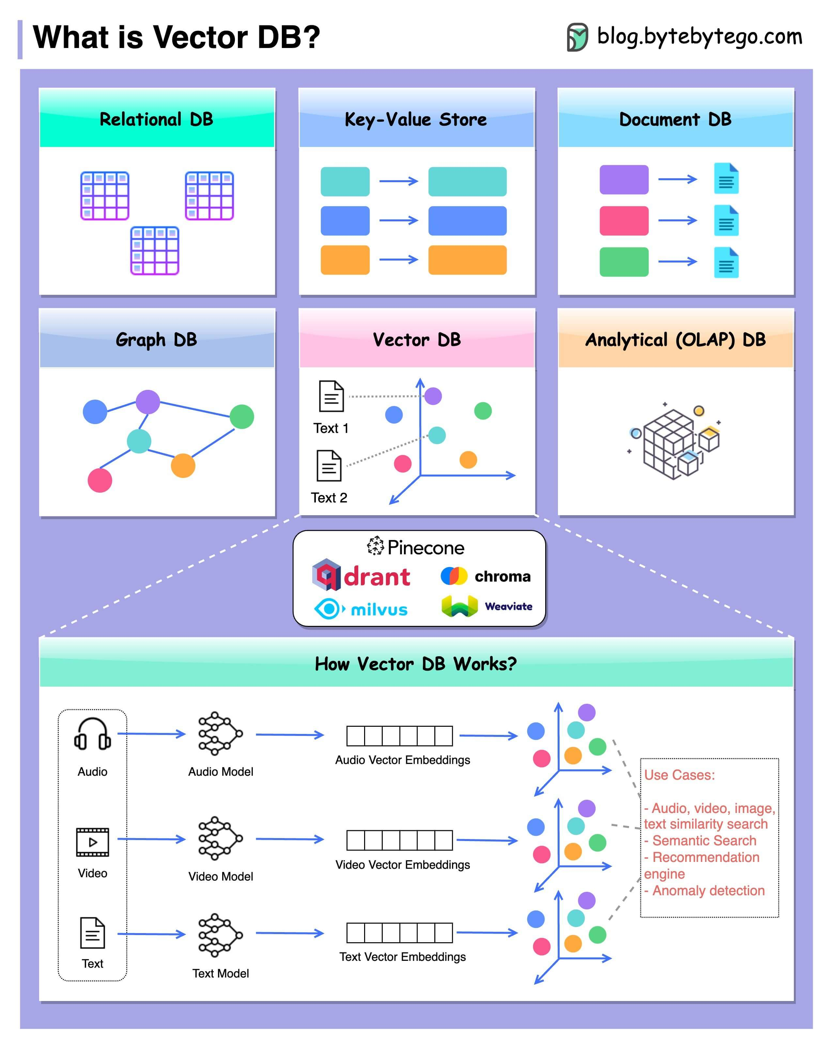
Introduction - Vector Database (1 of 5)
What is vector database?
Store, manage and retrieve data in form of high-dimensional vectors
Find the most similar vectors based on distance metrics
Vector Database
Notes:
What is vector database?
Differ from traditional DB, like relational DB, graph db,
Vector database stores vectors, which comes from unstructured data.
A vector database is a type of database designed to store, manage, and retrieve data in the form of high-dimensional vectors.
Vectors represent data as numerical arrays or points in a multi-dimensional space, and vector databases are optimized for performing operations like similarity search (e.g., finding the most similar vectors based on distance metrics such as cosine similarity or Euclidean distance).
They are widely used in applications like machine learning, recommendation systems, natural language processing, and image retrieval, where data such as text, images, or autios are transformed into vectors for efficient querying.

Slide 5
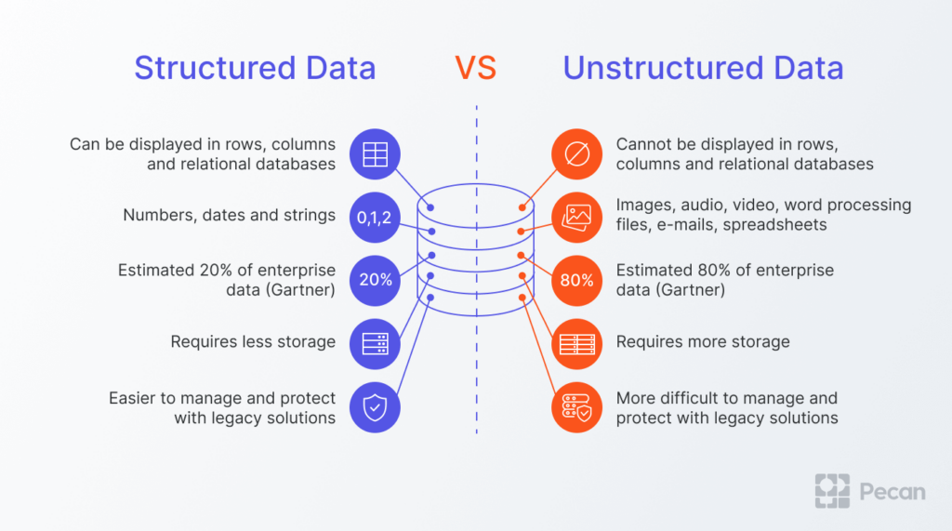
Introduction - Vector Database (2 of 5)
What is vector database?
Store, manage and retrieve data in form of high-dimensional vectors
Find the most similar vectors based on distance metrics
Notes:
What is unstructured data?
structured data is float, integer, or some accurate attribution, they can be sortedd in a fixed space in rows, colums in relational databases
But for autios, videos, text, images, their size is varied. And it is hard to say the relationship in different items. That is why we need vector database to handle this dataset to perform database retrival

Slide 6
Introduction - Vector Database (3 of 5)
Why we need vector database?
Efficient Similarity Search
Optimized for Machine Learning and AI
Notes:
As mentioned before, it is hard to query in a vector dataset.
For example, we want to find some images that are similar to the query’s image, we have to rely on vector database to get the most similar data.
It is widely used in recommendation.
For example, A user want to find a product, like a t-shirt. He upload a picture of this t-shirt, and then vector is generated by embedding model, a vector database then perofrm similarity searh to get the top k results. Then that is what we want.

Slide 7
Introduction - Vector Database (4 of 5)
Why we need vector database?
Efficient Similarity Search
Optimized for Machine Learning and AI
Notes:
Another usage of vector database is to enhance the performance of LLM.
RAG.
Sometimes LLM can not provide accurate result because it doesn’t know the relative information.
So before querying LLM, we retrive vector database firt to get some useful information. Then we input both prompt and retrival result to the LM. In this way we get more accurate and persuative responce.
Basically, thes two usage make vector database popular in recent reays.

Slide 8
Introduction - Vector Database (5 of 5)
Components of vector database
Data Storage (Metadata, Vector)
Embedding models (CLIP)
Indexing Mechanism (graph, tree, quantization)
Query Engine (Cosine, Euclidean, Dot)
Query Interfaces (SQL-like)
Notes:
Then let’s talk about it architecture.
A vector database is a type of database designed to store, manage, and retrieve data in the form of high-dimensional vectors.
Vectors represent data as numerical arrays or points in a multi-dimensional space, and vector databases are optimized for performing operations like similarity search (e.g., finding the most similar vectors based on distance metrics such as cosine similarity or Euclidean distance).
They are widely used in applications like machine learning, recommendation systems, natural language processing, and image retrieval, where data such as text, images, or embeddings are transformed into vectors for efficient querying.

Slide 9
vector database
Introduction
Related Work (6 pages)
Proposed Methods
Conclusions
Notes:
Now we can take a look at some popular vector databases.
In this section, I don’t talke about the algorithms or techinacial details,
just show some examples and the developing trends aout vector database.

Slide 10
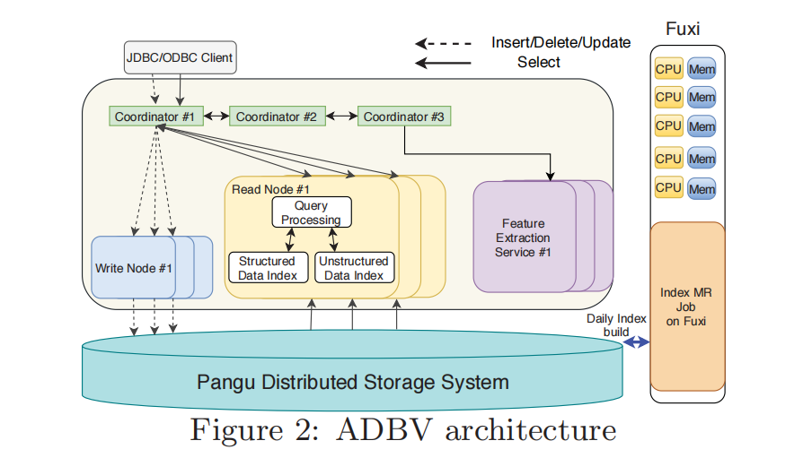
Related Work - Traditional VD (1/6)
AnalyticDB-V (Alibaba, 2020)
PG Vector (PostgreSQL vector database, 2020)
Microsoft VBASE (Microsoft, 2022)
SQL dialects
Arbitrary operations
Notes:
I put these three vector databases together is because, they are not a new architecture designed for vector search.
Insead. they developed from traditional relational database, sotring and querying in traditional method. Like SQL dialects.
We can see inthe ADBV architecture, it support not only unstructured data, but also structured data. So rather than calling it
vector database, it is more like relational database with some extra functions.

Slide 11
Related Work - Traditional VD (2/6)
AnalyticDB-V (Alibaba, 2020)
PG Vector (PostgreSQL vector database, 2020)
Microsoft VBASE (Microsoft, 2022)
SQL dialects
Arbitrary operations
Demo of Vector Search In PG Vector
Notes:
But because of the combination with relational database, they can perform many operations liak broup by, merge and other SQL dialects.
For example, PGvector, it can perform similarity search in such instructions.

Slide 12
Related Work - Traditional VD (3/6)
AnalyticDB-V (Alibaba, 2020)
PG Vector (PostgreSQL vector database, 2020)
VBASE (Microsoft, 2022)
SQL dialects
Arbitrary operations
Demo of Vector Search In MSVBASE
Notes:
Similar to MSVBASE from micorsoft.
There are all the prototype of vector database
because it is hard to say they are designed for vector query.
It is just a relational database extrally added some functions that can support vector search.
So these database is of low efficiency.

Slide 13
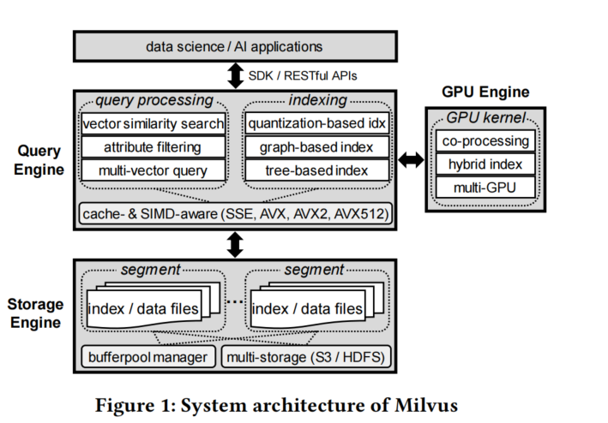
Related Work – Milvus (4/6)
Milvus (Zilliz, 2022)
Fully combination with traditional DB
Arbitrary operations
GPU supportance
Distributed database
Scalibility
Notes:
But milvus is completely different.
It is completely designed for vector database.
Supported by the latest algorithms, Milvus have much higher performance than those traditional database.
So that’s why milvus is currently popular in the research of RAG.

Slide 14
Related Work – Milvus (5/6)
Milvus (Zilliz, 2022)
Fully combination with traditional DB
Arbitrary operations
GPU supportance
Distributed database
Scalibility for billion scale data
Notes:
In milvus, we can use several methods to index database, and it also support GPU acceleration, SIMD scceleration, distributed storage, and large scale dataset.
Here is an example on how to search in kilvus using python API.
collection name is the database we want to search
data is the qeruy vector
limit is k in top k query. If we want to return 2 results, limit is 2
output files means which files of dataset will be returned

Slide 15
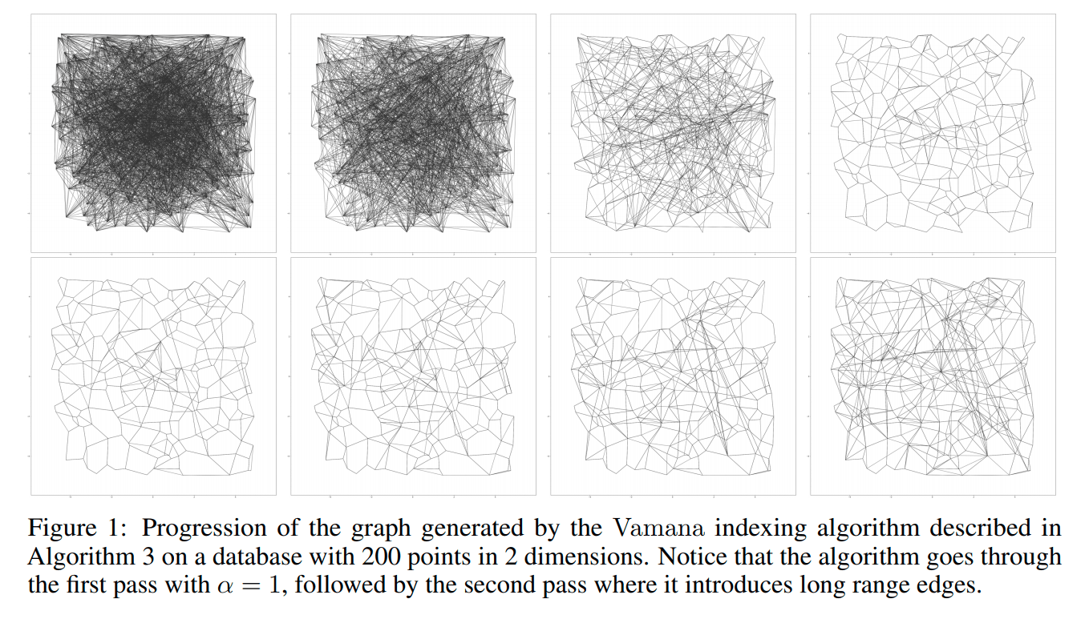
Related Work – DiskANN (6/6)
DiskANN (Microsoft, 2019)
Vamana graph
Disk index
Fast retrival
High recall
Althorithmic optimization
Notes:
DiskANN is of high performance as it is completely designed for ANN search. Several optimizations are designed to accerlate the algorithm.
Such as vamana graph, which is different form HNSWUnlike Milvus and PGVector, they can perform arbitrary traditional database operations
Unlike the former vector databases, diskann mainly focus on the efficiency.
It has pros and cons.
The pros are it is hof high performance in querying
The cons are it only support similarity search and some certain labels.
For example, DiskANN can retrival a red dress, but can’t figure out tis brand, prise, and other attributions.
Generally, only traditional ANN search and Label search are supported.

Slide 16
Vector database
Introduction
Related Work
Proposed Methods (31 pages)
Algorithm (18 pages)
System (5 pages)
Experiments (4 pages)
Future (4 pages)
Conclusions
Notes:
Then I will talk about the proposed methods
I am going to talk about it in three different aspects.
Algorithm system and trend

Slide 17
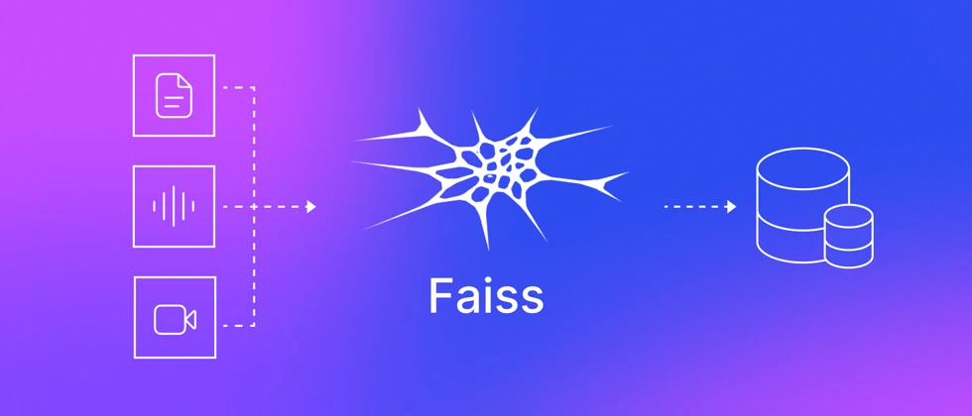
Proposed Methods: Algorithm (1 of 18)
Proposed System/Algorithm:
DiskANN
Jayaram Subramanya, Suhas, et al. "Diskann: Fast accurate billion-point nearest neighbor search on a single node." Advances in Neural Information Processing Systems 32 (2019).
Gollapudi, Siddharth, et al. "Filtered-diskann: Graph algorithms for approximate nearest neighbor search with filters." Proceedings of the ACM Web Conference 2023. 2023.
Faiss
Douze, Matthijs, et al. "The faiss library." arXiv preprint arXiv:2401.08281 (2024).
Notes:
Among all vector database vector databases， I propose DiskANN and Faiss to share in this seminar.
All of which is not SOTA but still famous for its classic high performance algorithms and its open sourced library.
Before talking ablout this two batabases, I will talk about the algorithms they used.

Slide 18
Proposed Methods: Algorithm (2 of 18)
Sequence:
HNSW (Classic, implenmented by Faiss)
Vamana Graph (DiskANN)
Product Quantization (Faiss)
Inverted File (Faiss)
Notes:
The sequence of the presentation in algorithm is HNSW, Vamana graph, product quantization, inverted file.
Among them, hnsw is not first introduced by faiss, but its library is implemented by faiss and widely used.
It is so classicial that I have to introduce it first.

Slide 19
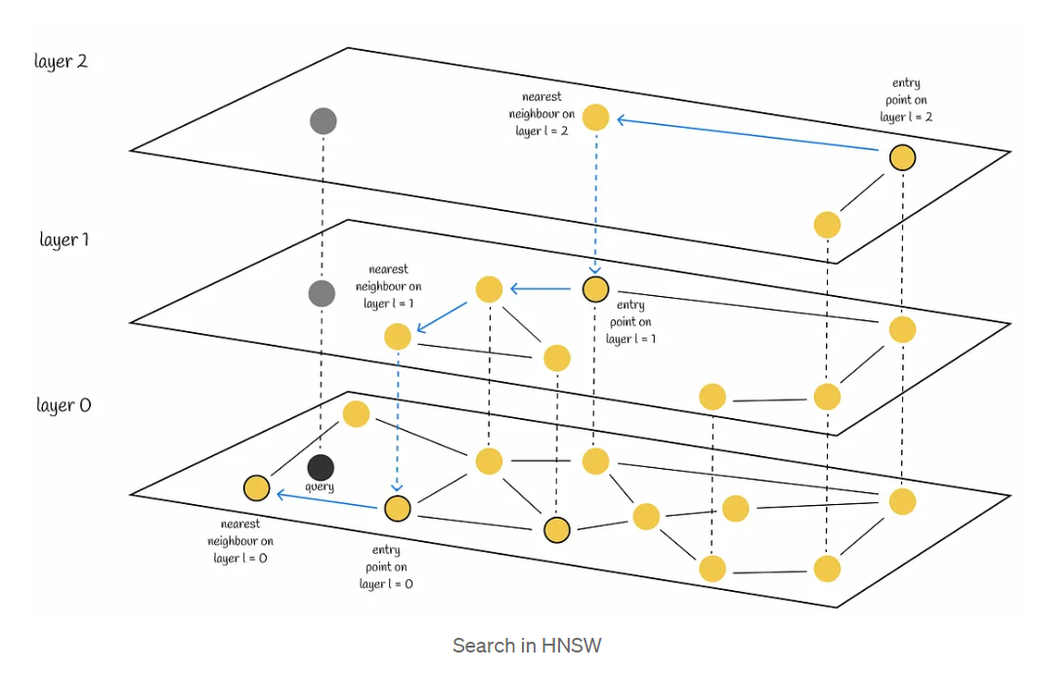
Proposed Methods: Algorithm (3 of 18)
HNSW (Hierarchical Navigable Small Worlds)
Query: gray point
Dataset: yellow point
Notes:
Firstly, I ‘d like to share HNSW
This is a classic structure to index and query vector data.
It contains multy layers, a search is performed from top to bottom.
As you can see, as the search goes to the bottom, more points is inside the graph

Slide 20
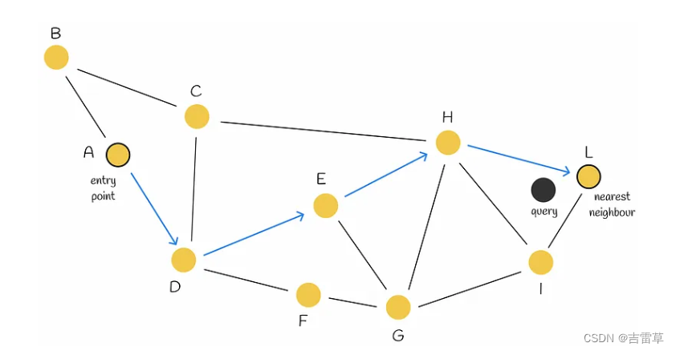
Proposed Methods: Algorithm (4 of 18)
HNSW (Hierarchical Navigable Small Worlds)
Search in a layer
Notes:
Specifically, in each layer, a beam search is performed.
For example, in a certain layer, we search the nearest neighbors of query from entray point A.
We will iterate the neighbors of A, and find closer points.
Most of time, we will find more than one candidates to get a more accurate result.

Slide 21
Proposed Methods: Algorithm (5 of 18)
HNSW (Hierarchical Navigable Small Worlds)
HNSW Insertion:
1. For each node, generate random layer r.
2. From layer r to layer 0, insert into current layer’s graph. (Neighbor size is fixed)
Notes:
In the onstruction step of HNSW, we only need to insert each node to some layers, to construct a multi-layer graphs
there are two steps
for each vector to be inserted
1st, randomnize to get a random layer
2nd, from the random layer to layer 0, insert it.
It is simple but there are still a problem.
If there are too much points that colse to curren point?
Then we need to prune thenm

Slide 22
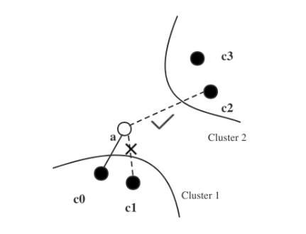
Proposed Methods: Algorithm (6 of 18)
HNSW (Hierarchical Navigable Small Worlds)
Prune While Inserting:
Connect as sparse as possible
To insert a, c0, c1, c2 are canditates
C0 is closer to c1 than a, so donot connect c1
Notes:
Here is te example how to porune.
Assume taht we only need to connect 2 neighbors. but 3 points is close to point a.
There are c0 c1 and c2
then pruneing is performed
The key idea of pruning is connect as sparse as possible.
that is , if a node is closer to one of its neighbors, donot connect it.
so we Don’t connect c1 connect c2 instead
This idea ensures the connectivity and scalibility of NN graph

Slide 23
Proposed Methods: Algorithm (7 of 18)
HNSW (Hierarchical Navigable Small Worlds)
HNSW query:
1. Start from top layer, run beam search to get candidates for next layer.
2. In layer 0, after beam search, re-rank candidates to get top-k results.
Notes:
Now the HNSW index in constructed. we can search nearest neighbors on it.
recall the image, we start from the entry point in the top layer, get nearest neighbors in the layer using beam search.
And then start from thosse candidates generated by previous layser’s beam search, search again,
till the layer 0, we get the nearest neigbhors.
That is the key idea of HNSW.

Slide 24
Proposed Methods: Algorithm (8 of 18)
Vamana Graph(DiskANN)
Index Construction
1. Random connection
2. Calculate centroid
3. Start from centroid, run ANN Search for all nodes, and prune to get neighbors.(alpha=1)
4. Search and prune again to get more accurate graph.(alpha=1.2)
ANN Search
Beam Search
Notes:
Now we can talk about another graph based index. It is used by DiskANN
It is vamanaa graph.
Un like HNSW, vamana graph is only one graph. It is constructed as follows.
Pruning is similar to HNSW, but vamana graph only uses 2 rounds to construct the index.

Slide 25
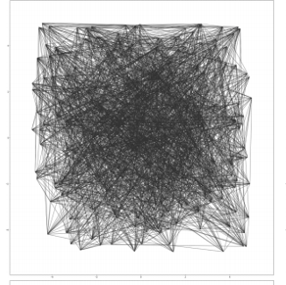
Proposed Methods: Algorithm (9 of 18)
Vamana Graph(DiskANN)
Index Construction
1. Random connection
2. Calculate centroid
3. Start from centroid, run ANN Search for all nodes, and prune to get neighbors.(alpha=1)
4. Search and prune again to get more accurate graph.(alpha=1.2)
Notes:
Now we can talk about another graph based index. It is used by DiskANN
It is vamanaa graph.
Un like HNSW, vamana graph is only one graph. It is constructed as follows.
We connect it randomly

Slide 26
Proposed Methods: Algorithm (10 of 18)
Vamana Graph(DiskANN)
Index Construction
1. Random connection
2. Calculate centroid
3. Start from centroid, run ANN Search for all nodes, and prune to get neighbors.(alpha=1)
4. Search and prune again to get more accurate graph.(alpha=1.2)
Notes:
Then calculate and get a centroid
Mention that centroid is not a center.
centroid is a actual point that closest to the center

Slide 27
Proposed Methods: Algorithm (11 of 18)
Vamana Graph(DiskANN)
Index Construction
1. Random connection
2. Calculate centroid
3. Start from centroid, run ANN Search for all nodes, and prune to get neighbors.(neighbor size=M*alpha, where alpha=1)
4. Search and prune again to get more accurate graph.(where alpha=1.2)
Notes:
Then It perform ANN search for each point.
It is the same to beam search
and, when

Slide 28
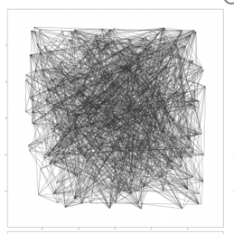
Proposed Methods: Algorithm (12 of 18)
Vamana Graph(DiskANN)
Index Construction
1. Random connection
2. Calculate centroid
3. Start from centroid, run ANN Search for all nodes, and prune to get neighbors.(neighbor size=M*alpha, where alpha=1)
4. Search and prune again to get more accurate graph.(where alpha=1.2)
Notes:
After first round ann search and connection,
each node connects some nodes that are close to them,
but it is not accurate enougt.

Slide 29
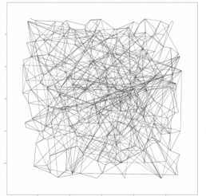
Proposed Methods: Algorithm (13 of 18)
Vamana Graph(DiskANN)
Index Construction
1. Random connection
2. Calculate centroid
3. Start from centroid, run ANN Search for all nodes, and prune to get neighbors.(neighbor size=M*alpha, where alpha=1)
4. Search and prune again to get more accurate graph.(where alpha=1.2)
alpha: control the neighbor size.
if M=40, then get 40(40*1) neighbors in round 1, 48(40*1.2) neighbors
Short edges can help find its nearest neighbors
Long edges can help converge faster
Notes:
SO we search and prune again, to get the final graph.
It is much sparse, only a few of edges connect to the remote neighbors
There still remains some long edges that randomly

Slide 30
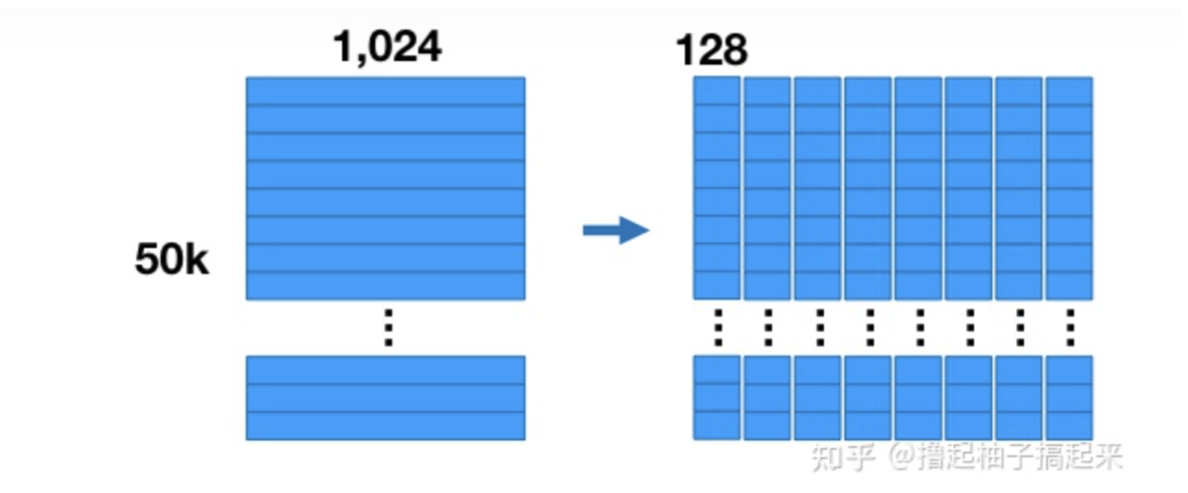
Proposed Methods: Algorithm (14 of 18)
Product Quantization (Faiss)
Index Construction
1. Split high dimentional vector into sub-vectors
Notes:
Other than graph based index method, there are some partition based methods.
For example Product QWuantization, PQ in short.
Focuses in high dimentional search.
For example, we have got fifty kilio vectors with one hundred and twenty four dimensions.
It gonna expensive to search all these vectors.
So we split it into 8 into 8 sub vectors, each subvector holds 128 dimensions.

Slide 31
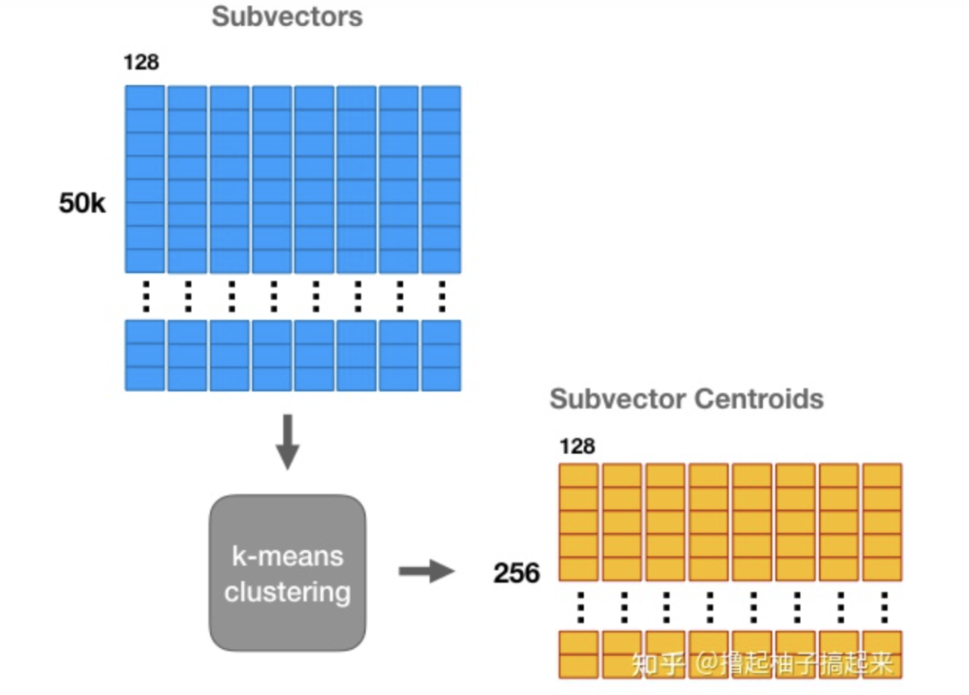
Proposed Methods: Algorithm (15 of 18)
Product Quantization (Faiss)
Index Construction
2. For sub space, K-means clustering into 256 centorids
Notes:
Then we use k-means algorithm to get 256 centroids.

Slide 32
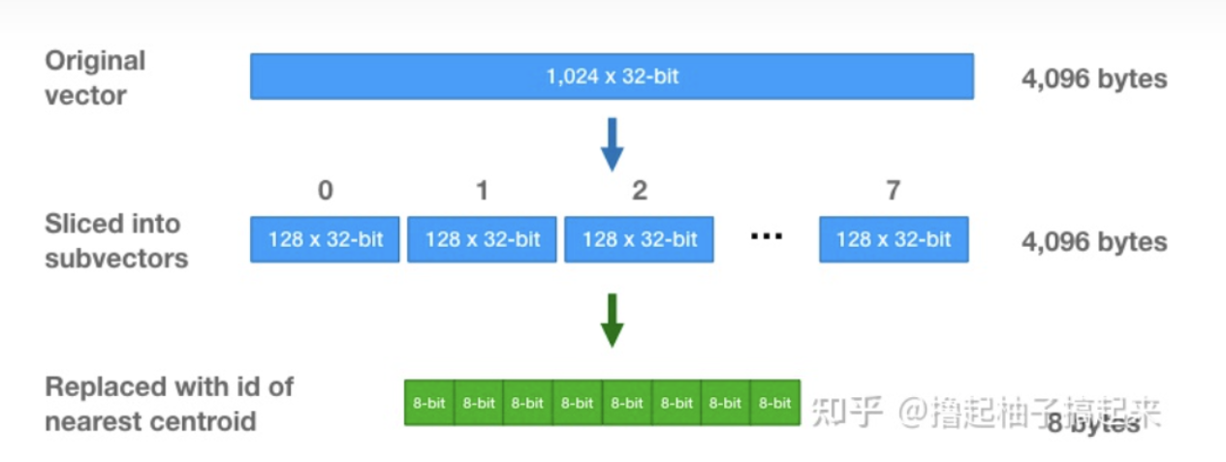
Proposed Methods: Algorithm (16 of 18)
Product Quantization (Faiss)
Index Construction
3. Use the centorids to represent the original vector
Notes:
for each vector, we use the closest centroid to represent the sub vector
So we can use a 8bit to represent 128*32-bit sub vector
That is what we call quantilization

Slide 33
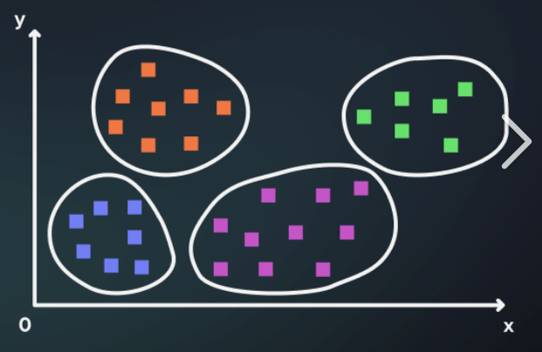
Proposed Methods: Algorithm (17 of 18)
Invered File Index (Faiss)
Index Construction:
1. Get centroids using k-means
2. Assign data to the closest cluster
Query:
1. perform distance computation in top n nearest clusters
Notes:
Another key idea of faiss is Inverted file index, it is very simple
We use k-means to get centroids and clusters for original vector
In each cluster, we compute all distances from query to all vectors inside the clusters

Slide 34
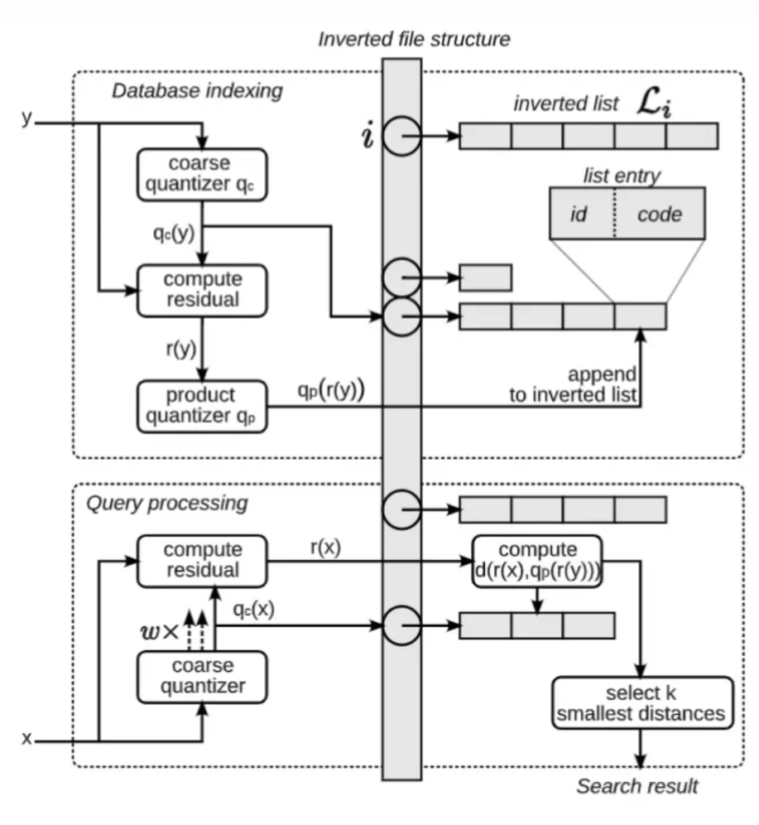
Proposed Methods: Algorithm (18 of 18)
IVF-PQ (Faiss)
Index Construction
1. k-means clustering for raw vector
2. PQ for each clusters
3. Store the PQ code
Search
1. Calculate distance to all centorids
2. in top n clusters, compute distance using PQ code
Notes:
Generally faiss is famous for IVF-PQ architecture, which use both IVF and PQ algorithms.
This figure shows how it works.
First we use k-means clustering, like IVF, to split the dataset
in each dataset let each vector subtract its centroid to get residual
Then we use product quantization to get PQ code, assgn them to the inverted file list
When we perform ANN search, we query top n clusters.
Then we compare the quantized distance. get the closes results.
It is not so accurate, but it is efficient.

Slide 35
Vector database
Introduction
Related Work
Proposed Methods (31 pages)
Algorithm (18 pages)
System (5 pages)
Experiments (4 pages)
Future (4 pages)
Conclusions

Slide 36
Proposed Methods: System (1 of 5)
DiskANN
1. Partitioned graph
2. PQ index
In Disk
PQ Index
Subgraph
In Memory
Notes:
Apart from vamana graph, there are still many algorithms that we have to focus on in DiskANN.
Remember that it is call Disk ANN just because it is friendly to disk IO.
There shows how it is designed for IO optimization.
After construction, index is stored in disk to save memory footprint.
PQ index is constructed inside memory
When search is called, Disk ANN uses PQ index to get some rough results, to checkout which part should be loaded into memory
then perform graph search .
To reduce IO frequency, each subgraph copies it 1 hop neighbor, so that less subgraph are needed to load into memory in one search.

Slide 37
Proposed Methods: System (2 of 5)
DiskANN
Graph partition
Vamana subgraph
1. Clustering before graph constrution
2. Assign points to 2 nearest clusters
3. Run graph construction in subset
advangage:
Save memory footprint
Reduce IO frequency
In Disk
Notes:
This part shows how subgraph is constructed
FIrst we perform k-means clustering
and each point is asigned to 2 clusters
In each subset, we perform vamanagraph construction
In that way, the dumplicted points ensured the connectivity between different subgraphs
And the subgraph is much smaller than original datasize, it is easy to fit into memory

Slide 38
Proposed Methods: System (3 of 5)
DiskANN
Search Acceleration
PQ index
1. PQ roughly to get subgraph
2. search on subgraph
advangage:
computation in little memory footprint
Reduce IO
In Disk
PQ Index
Subgraph
In Memory
Notes:
The latest Diskann combined with PQ algorithm.
In memory , PQ index is constructed and stored in memory permantely.
because pq index is small
then we can use pq index to find out rough results
and then we can search on subgraph again to get top k results.

Slide 39
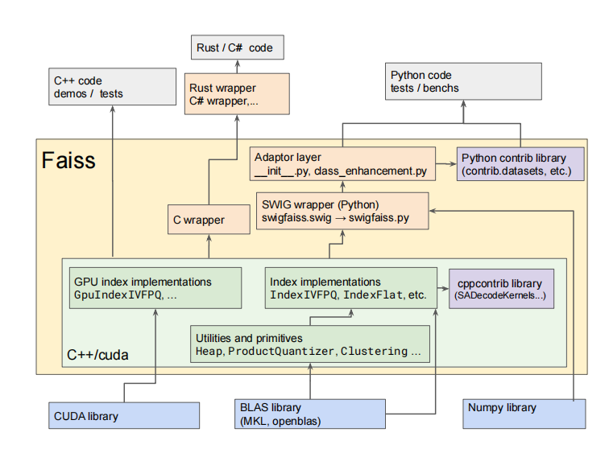
Proposed Methods: System (4 of 5)
Faiss (Facebook AI Similarity Search)
More like a library
First introduced IVF-PQ architecture
HNSW、HNSW+PQ、IVF、IVF+PQ
GPU acceleration
SIMD acceleration
Notes:
Faiss is more like a library than a system.
It provides HNSW, PQ IVF HNSWPQ IVFPQ etc.
It also provides GPU acceleration and SIMD accleration

Slide 40
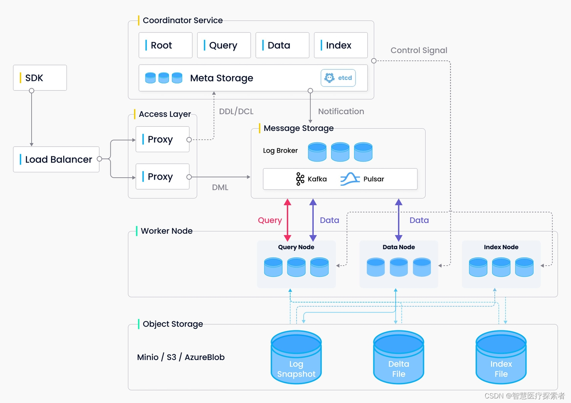
Proposed Methods: System (5 of 5)
Milvus
Industrial Levle Design
Distribute Storage
Support HNSW、IVFPQ...
GPU Acceleration
Notes:
Milvus is designed based on faiss so I would like to talk about it.
It is recently really commonly used in RAG research.
Milvus is a industrial application designed by Zilliz
It is well designed in both standalone and distributed version.
Supports HNSW, IVF, PQ, etc.
Hybrid query, such as image with some attributions.
Plus, it supports GPU acceleration.
DIstributed service

Slide 41
Introduction
Related Work
Proposed Methods (31 pages)
Algorithm (18 pages)
System (5 pages)
Experiments (4 pages)
Future (4 pages)
Performance Evaluation
Conclusions
Vector database
Notes:
Then let’s take a look of experiments of Diskann and Faiss

Slide 42
Proposed Methods: Experiments (1 of 4)
DiskANN
Notes:
Here is some of the experiments of disk ann
dataset are sift1m gist1m deep1m respectively
vamana with green lines are diskann
the top left is better because it got higher recall with lower latency
nsg is designed by another paper publish by alibaba
vamana is better than hnsw and nsg

Slide 43
Proposed Methods: Experiments (2 of 4)
DiskANN
Notes:
The best adbantage of diskann is it can suppore large scale dataset
figure (a) constructs different vamana graph in different way to get different recall an latency.
r128 shows one-shot vamanagraph which means construct graph directly without subgraph. so other methods with partition method get lower recall/latency
figure(b) shows recall/latency in deep1b
figure(c) shows in sift 1m, vamana uses less degree to get lower qps

Slide 44
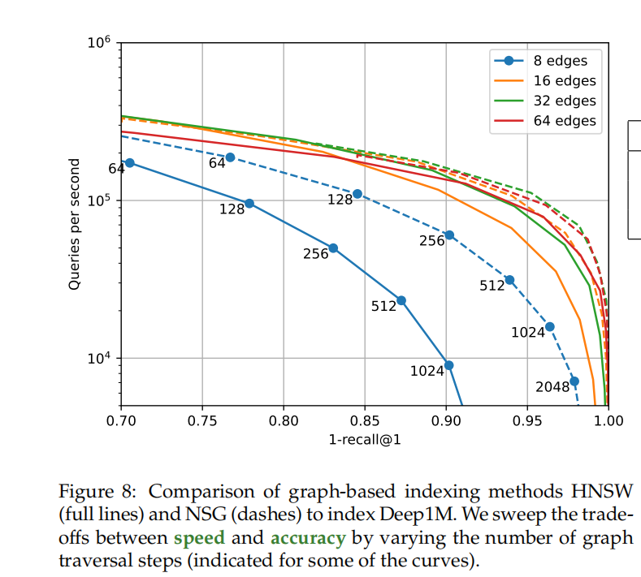
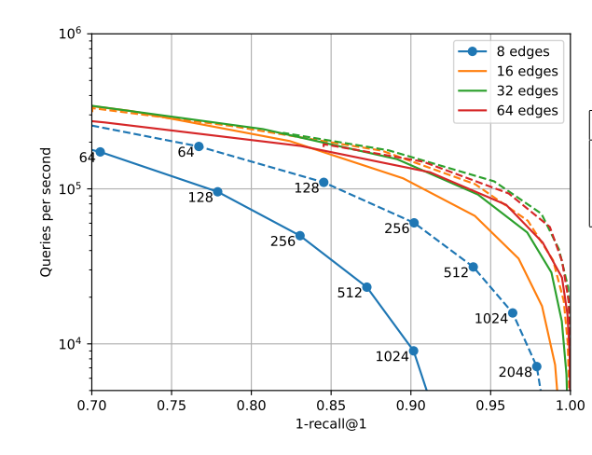
Proposed Methods: Experiments (3 of 4)
Faiss
Notes:
in Faiss, HNSW is implemented can compared with NSG
the full line is HNSW
dotted line is NSG
we can see that hnsw got higher recall with higer qps at the same settings

Slide 45
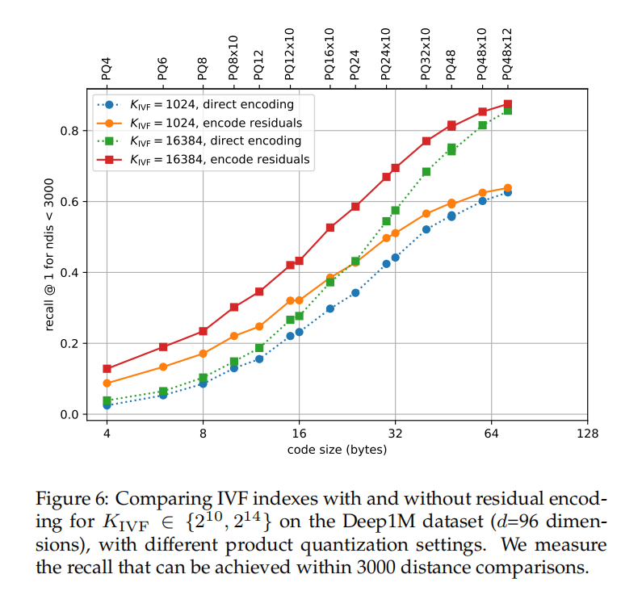
Proposed Methods: Experiments (4 of 4)
Faiss
Notes:
There is the experiment of IVF with different encoding methods.
In different code size, longer code brings higher recall
More centroids visited per query brings higher recall
residual encoding got higher recall

Slide 46
Vector database
Introduction
Related Work
Proposed Methods (31 pages)
Algorithm (18 pages)
System (5 pages)
Experiments (4 pages)
Trend (4 pages)
Performance Evaluation
Conclusions
Notes:
In this part, I will present several other papers to show the latest researches

Slide 47
Proposed Methods: Trends (1 of 4)
Hybrid Search
Search a image/text/video with timestamp/prise/attributions
Notes:
Although vector database is now widely used. It is still in optimization.
For example, it is hard for a graph-based index to perform hybrid search, but it is essential for any database,
We want to retrival a dress which looks lite a image I provided.
But I still want it is red.
What’s more, I want to resist its brand, prise, material, and so on.
How do we design the vector database?
How do we combine the vector database with relational database?
So here come to some solution.

Slide 48
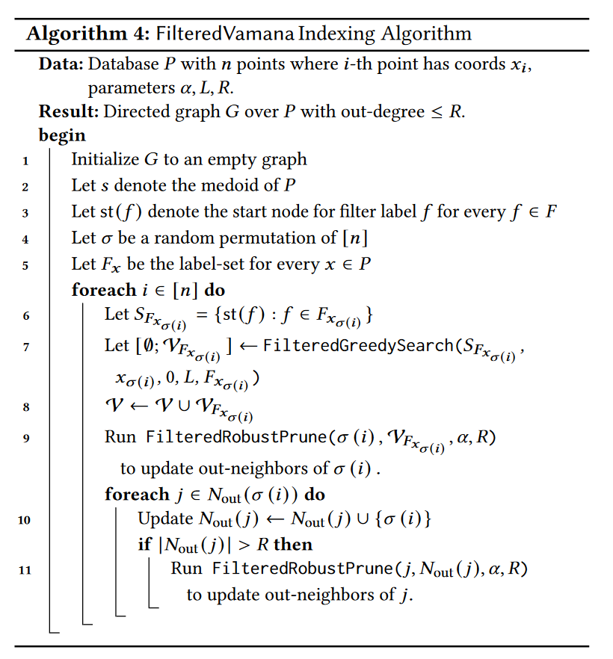
Proposed Methods: Trends (2 of 4)
Hybrid Search Example
label query: filtered DiskANN
Notes:
First thing is filtered Disk ANN
In this algorithm,
It construct sub graph for each label
and then combine all subgraphs together.
So when we retrival a vector, we can use both subgraph’s neigbhor and general graph’s neighbors

Slide 49
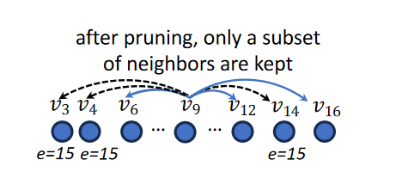
Proposed Methods: Trends (3 of 4)
Hybrid Search Example
range query: SeRF(Segment RangeFiltering)
Notes:
Another solution is SeRF, which I think it is SOTA nowadays.
SeRF is designed based on HNSW.
But it don’t prune redundant edges.
It split all its neighbors into 2 parts, greater than itself and smaller than itself.
when a query comes, it compare with it own to decide which part of neighbors should be considered.
Of course there are some methods to reduce the index size.

Slide 50
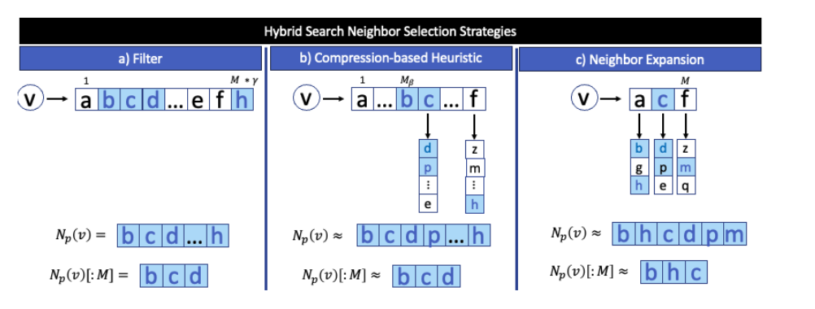
Proposed Methods: Trends (4 of 4)
Hybrid Search Example
arbitrary search: ACORN
Notes:
Un like the previous 2 methos, FIltered DiskANN only supports label based filter
SeRF only supports one label range query.
ACORN supports arbitrary label size, format.
The key idea of ACORN is to connect more neighbors.
Specifically, 2-hop neighbors are connceted.
Which is heuristic, but efficient

Slide 51
Vector database
Introduction
Related Work
Proposed Methods
Conclusion (1 page)

Slide 52
Conclusion (1 of 1)
Vector Database
Components: Vector Embedding, Data Storage, ANN
Application
Recommendation
RAG
System
Traditional: AnalyticDB-V, PGvector, VBase
New: DiskANN, Faiss, Milvus
Algorithm
Graph based
Quantization Based
Future
Hybrid filtering
Notes:
traditional architecue
new architecture
algorithm
new research field:

Slide 53
Thanks for listening.

