Slide 1
Disaggregating Prefill and Decoding: A System Optimization Approach for Large Language Model Serving 2024.10.31
Ye Wang
School of Data Science
Chinese University of Hong Kong, Shenzhen

Slide 2
Outline
Introduction (4 min)
Preliminaries (10 min)
Analysis & Motivation (5 min)
Why Disaggregate P & D?
Intuitive Implementation of Disaggregation
Tradeoff : Transfer Overhead vs Throughput Improvement
Proposed Methods (15 min)
Disaggregated Architecures Realizations
KV Cache Pool: Distributed Memory Management
Scheduling
Performance Evaluation (15 min)
Discussions (5 min)
Q/A (5 min)
Notes:
so we know that until now, another factor, KV Cache transfer overhead, has been introduced to the whole system to participate the tradeoff
previous factors trading off each other include
1. computation (maybe of heterogeneous GPUs),
2. communication cost (this means inter-layer comm),
3. as well as memory
so in this section, we will introduce how disaggregation creates more opportunities for trading off and how the proposed methods reach a better performance under this disaggregation paradigm

Slide 3
Introduction (1/2)
What is LLM
Difference between LLM and conventional models
LARGE model
Gigantic memory cost
High communication cost
High computation cabability requirement
Transformer layer: attention and mlp

Slide 4
Introduction (2/2)
MLSys conventional optimization approaches:
Parallelization: TP / PP / DP...
Quantization
Kernel optimization ...
LLMSys: Specific for Transformer layer’s architecture
One approach: Prefill and decoding disaggregation

Slide 5
Outline
Introduction (4 min)
Preliminaries (10 min)
Analysis & Motivation (5 min)
Why Disaggregate P & D?
Intuitive Implementation of Disaggregation
Tradeoff : Transfer Overhead vs Throughput Improvement
Proposed Methods (15 min)
Disaggregated Architecures Realizations
KV Cache Pool: Distributed Memory Management
Scheduling
Performance Evaluation (15 min)
Discussions (5 min)
Q/A (5 min)

Slide 6
Preliminaries-Outline
Conventional MLSys Approaches
Parallelism
GPU Resource Properties
Memory, Computation, Communication
What Are Prefill and Decoding
Transformer Layer Structure
KV Cache Mechanism
Prefill and Decoding
How previous problems are solved?
What can we leverage to solve this problem?
How this new problem in LLM is formed?

Slide 7
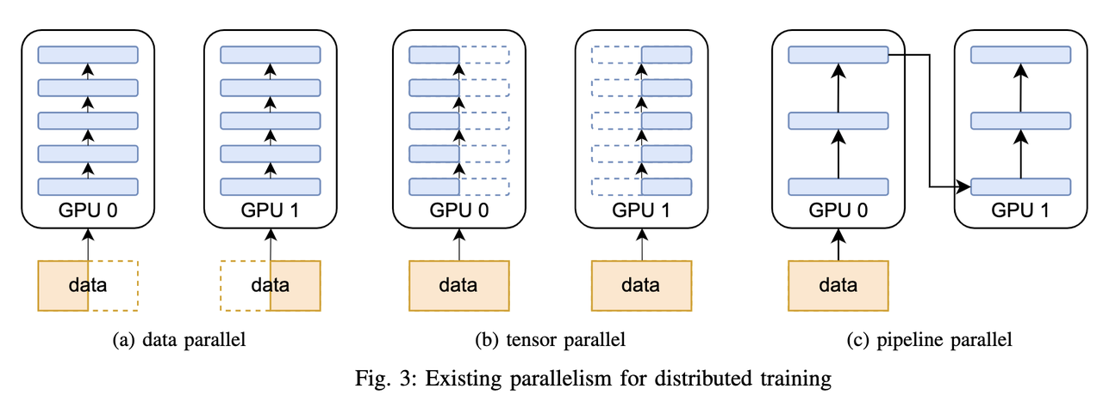
Preliminaries-Parallelism
Different kinds of Parallelism:
Data parallelism
Pipeline parallelism
Tensor parallelism
Expert parallelism
Mixed parallelism

Slide 8
Preliminaries-GPU Resource
Computation resources: heterogeneous GPUs
Data transfer:
Intra node: NVLink, PCI-e
Inter node: RDMA (IB / RoCE)

Slide 9
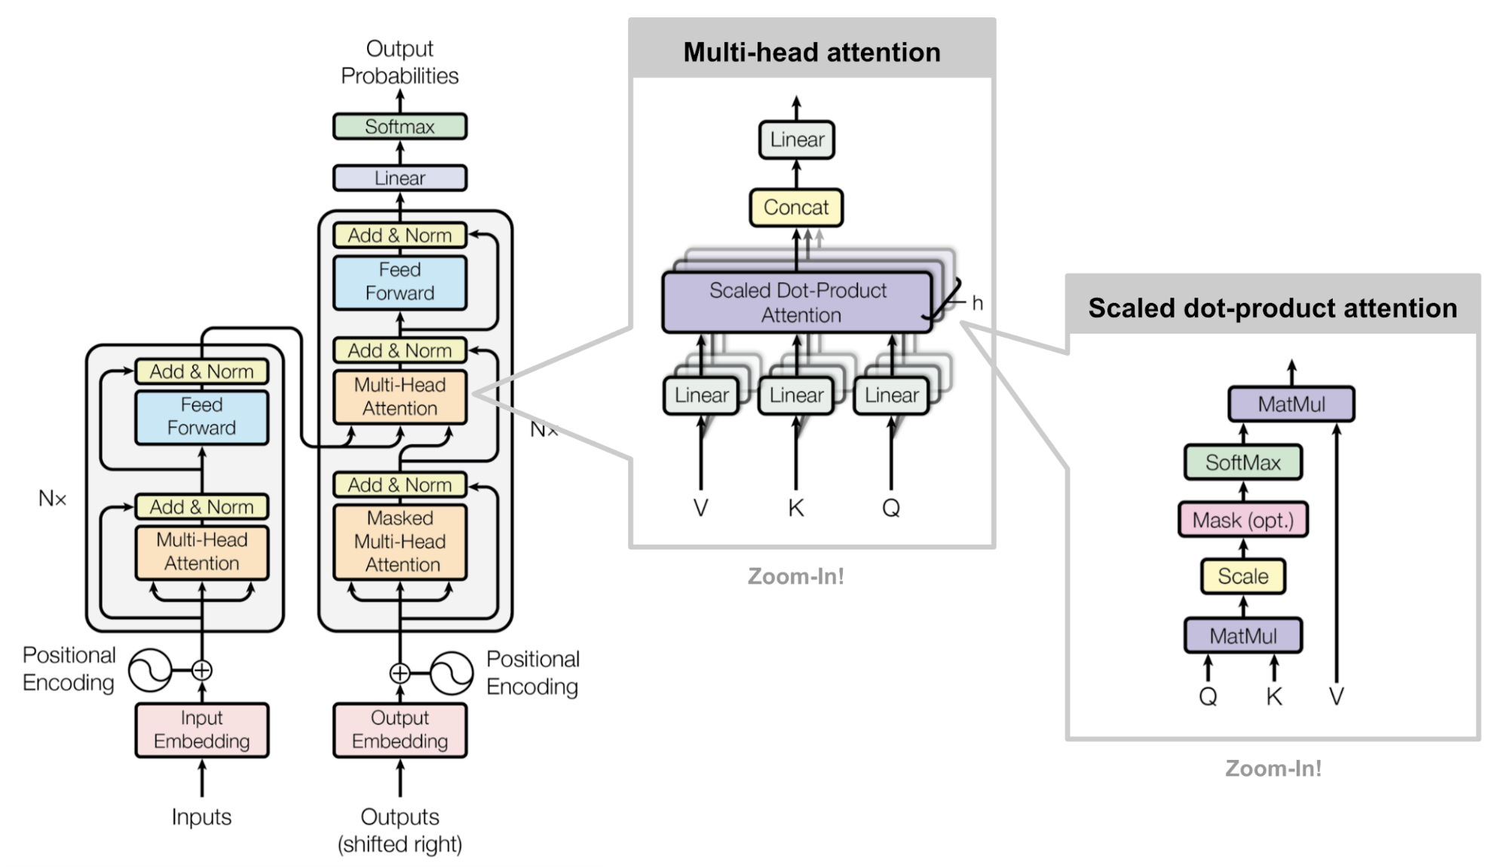
Preliminaries-Transformer Layer
One Transformer layer in LLM
Computing KV for each time
is too time consuming!

Slide 10
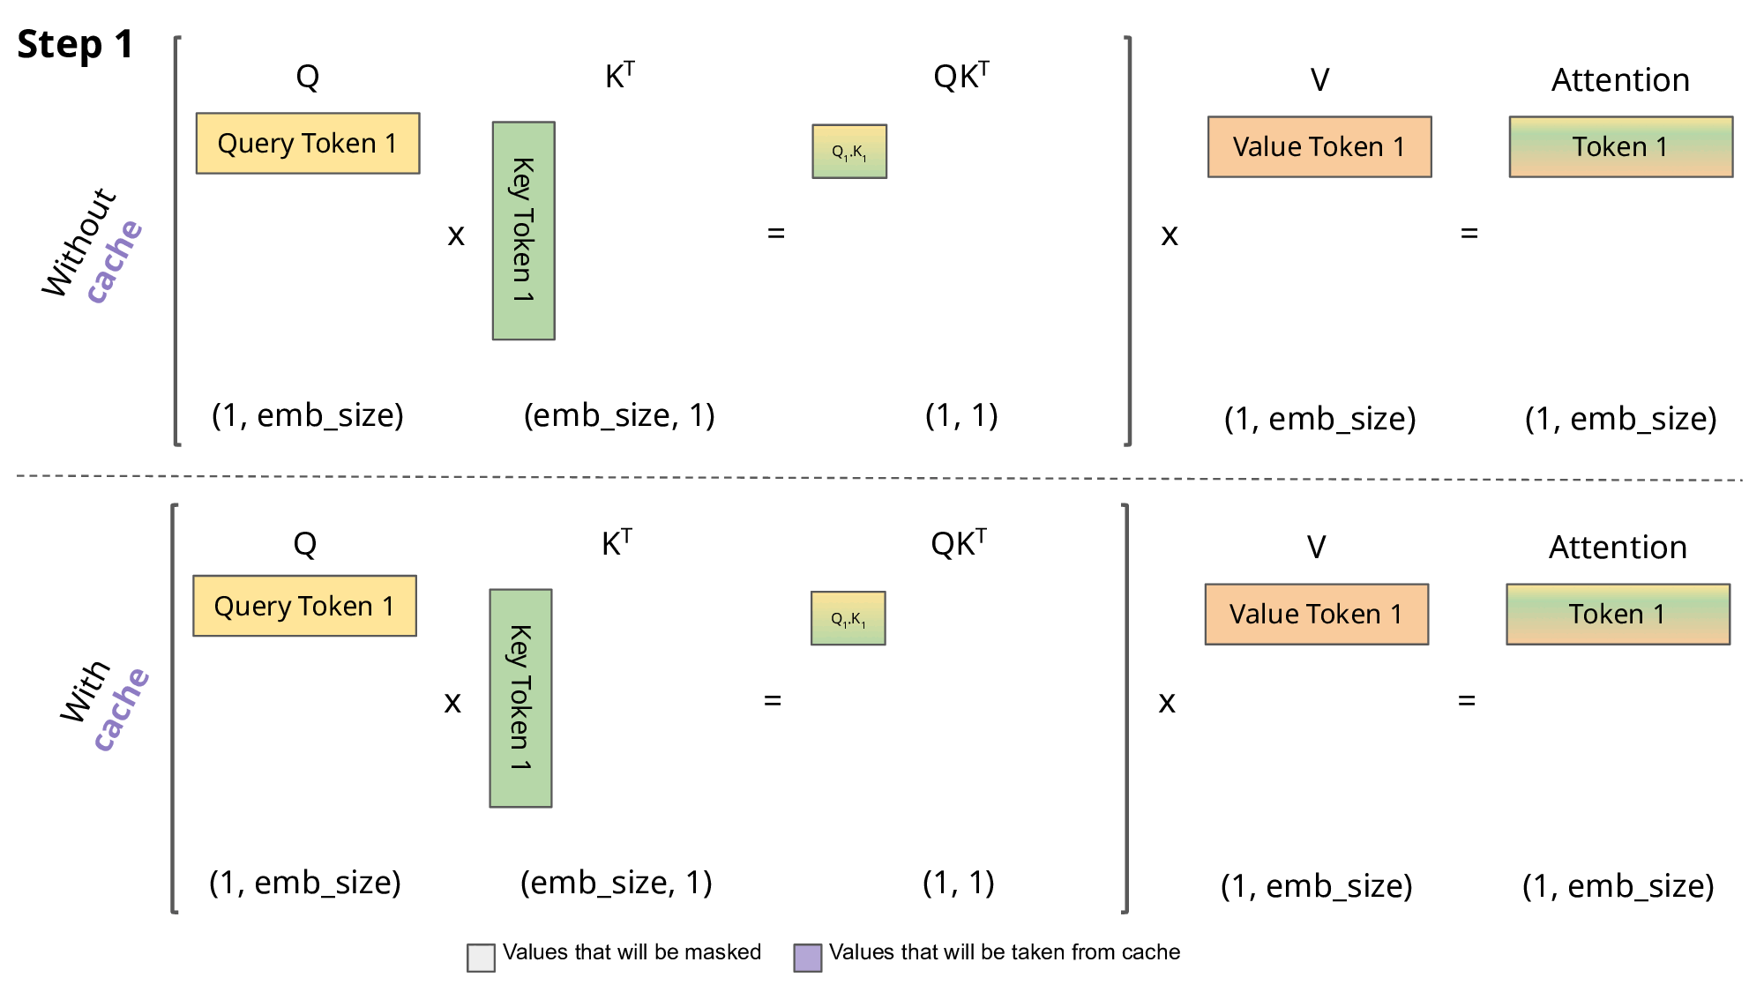
Preliminaries-KV Cache
Reduces time cost for calculating duplicate Keys and Values
An example: how KV Cache is used in inference
Notes:
Since the decoder is causal (i.e., the attention of a token only depends on its preceding tokens), at each generation step we are recalculating the same previous token attention, when we actually just want to calculate the attention for the new token.
This is where KV comes into play. By caching the previous Keys and Values, we can focus on only calculating the attention for the new token.
Why is this optimization important? As seen in the picture above, the matrices obtained with KV caching are way smaller, which leads to faster matrix multiplications.

Slide 11
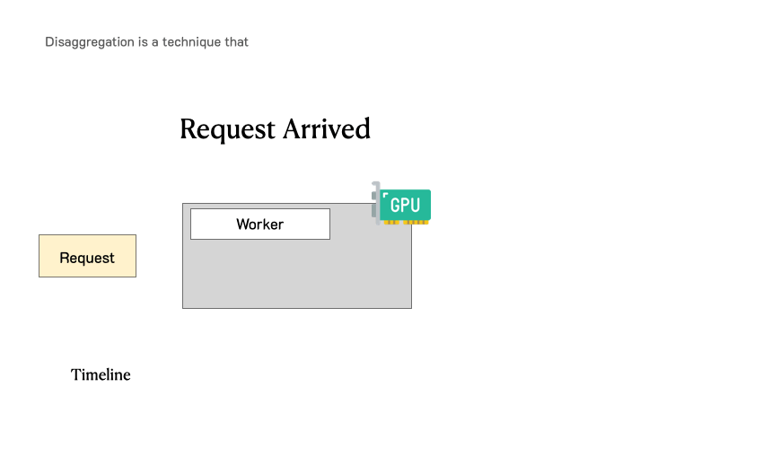
Preliminaries-Prefill and Decoding (1/2)
P for Prefill
Compute-bound
The first phase of LLM inference that digests all the input tokens, populates the KV Cache, and generates the first output token.
D for Decoding
Memory-bound
The subsequent phase that generates token-by-token until termination.
Notes:
However, the two phases have very distinct characteristics in computation. Prefill is very compute-bound, meaning a small batch of prefills or even a single long enough prefill will easily saturate GPU computation. On the other hand, decoding needs a much bigger batch size to hit the compute bound, and is more easily subject to the memory bandwidth limit of the GPU.
然而，这两个阶段在计算上具有非常不同的特征。预填充非常受计算限制，这意味着一小批预填充甚至单个足够长的预填充很容易使 GPU 计算饱和。另一方面，解码需要更大的批量大小才能达到计算极限，并且更容易受到 GPU 内存带宽的限制。
Due to their vastly different compute patterns and SLOs, colocating these two phases is not optimal for achieving high goodput because:
由于计算模式和 SLO 差异很大，将这两个阶段放在一起并不是实现高吞吐量的最佳选择，因为：
Collocating prefill and decode causes Interference between them.
预填充和解码的并置会导致它们之间的干扰。
Colocating prefill and decoding couples their resource allocation and parallelism strategies.
预填充和解码的共置结合了它们的资源分配和并行策略。
We explain them next. 我们接下来解释它们。

Slide 12
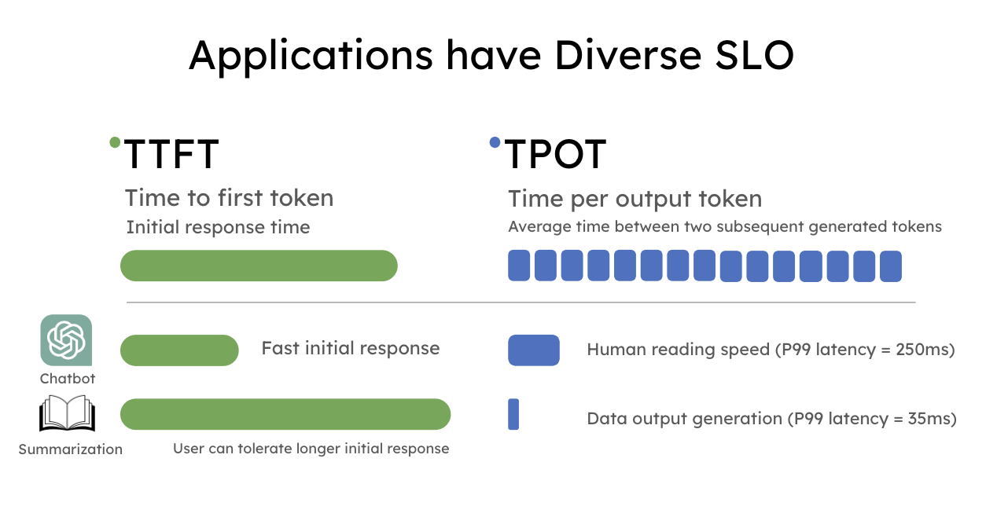
Preliminaries-Prefill and Decoding (2/2)
Service Level Objectives (SLO)
P for Prefill
TTFT
Time To First Token
D for Decoding
TPOT
Time Per Output Token

Slide 13
Outline
Introduction (4 min)
Preliminaries (10 min)
Analysis & Motivation (5 min)
Why Disaggregate P & D?
Intuitive Implementation of Disaggregation
Tradeoff : Transfer Overhead vs Throughput Improvement
Proposed Methods (15 min)
Disaggregated Architecures Realizations
KV Cache Pool: Distributed Memory Management
Scheduling
Performance Evaluation (15 min)
Discussions (5 min)
Q/A (5 min)
Notes:
so we know that until now, another factor, KV Cache transfer overhead, has been introduced to the whole system to participate the tradeoff
previous factors trading off each other include
1. computation (maybe of heterogeneous GPUs),
2. communication cost (this means inter-layer comm),
3. as well as memory
so in this section, we will introduce how disaggregation creates more opportunities for trading off and how the proposed methods reach a better performance under this disaggregation paradigm

Slide 14
Motivation-Why disaggregate P & D?(1/4)
Because...conventional colocating P & D:
1. Causes inteference between P & D
P & D have different compute patterns
P & D have different SLOs
2. Couples their resource allocation and parallelsim strategies
Notes:
However, the two phases have very distinct characteristics in computation. Prefill is very compute-bound, meaning a small batch of prefills or even a single long enough prefill will easily saturate GPU computation. On the other hand, decoding needs a much bigger batch size to hit the compute bound, and is more easily subject to the memory bandwidth limit of the GPU.
然而，这两个阶段在计算上具有非常不同的特征。预填充非常受计算限制，这意味着一小批预填充甚至单个足够长的预填充很容易使 GPU 计算饱和。另一方面，解码需要更大的批量大小才能达到计算极限，并且更容易受到 GPU 内存带宽的限制。
Due to their vastly different compute patterns and SLOs, colocating these two phases is not optimal for achieving high goodput because:
由于计算模式和 SLO 差异很大，将这两个阶段放在一起并不是实现高吞吐量的最佳选择，因为：
Collocating prefill and decode causes Interference between them.
预填充和解码的并置会导致它们之间的干扰。
Colocating prefill and decoding couples their resource allocation and parallelism strategies.
预填充和解码的共置结合了它们的资源分配和并行策略。
We explain them next. 我们接下来解释它们。

Slide 15
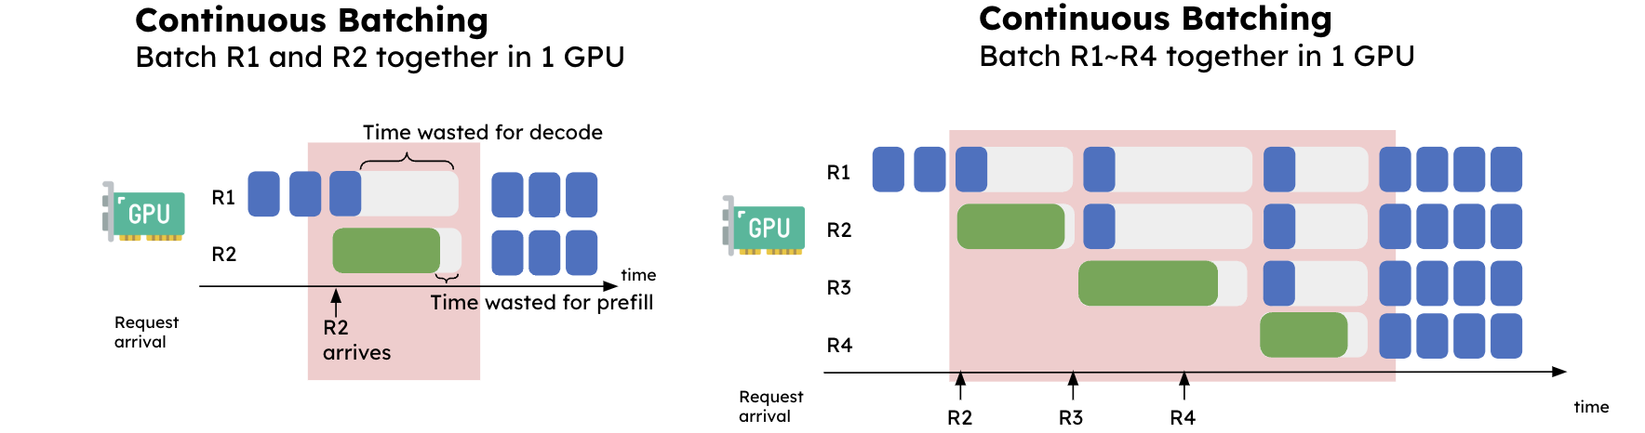
Motivation-Why disaggregate P & D?(2/4)
continuous
batching
3 ways of
batching
All show interference between prefill and decode!
(results in bubble time)
Notes:
This figure shows a simplified view of the interference between prefill and decode. On the very left, we batch these 2 requests together in 1 GPU. We can see that continuous batching significantly elongates the latency for R1 (decode), and at the same time slightly increases the latency for R2 (prefill). On the right, we have a steady stream of incoming requests. Now the requests in the decode phase get “bugged” every single time a prefill requests come into the system, causing an unexpectedly long delay on decode.
图 显示了预填充和解码之间的干扰的简化视图。在最左边，我们在 1 个 GPU 中将这 2 个请求一起批处理。我们可以看到，连续批处理显着延长了 R1（解码）的延迟，同时略微增加了 R2（预填充）的延迟。在右侧，我们有源源不断的传入请求。现在，每次预填充请求进入系统时，解码阶段的请求都会被“窃听”，从而导致解码出现意外的长时间延迟。

Slide 16
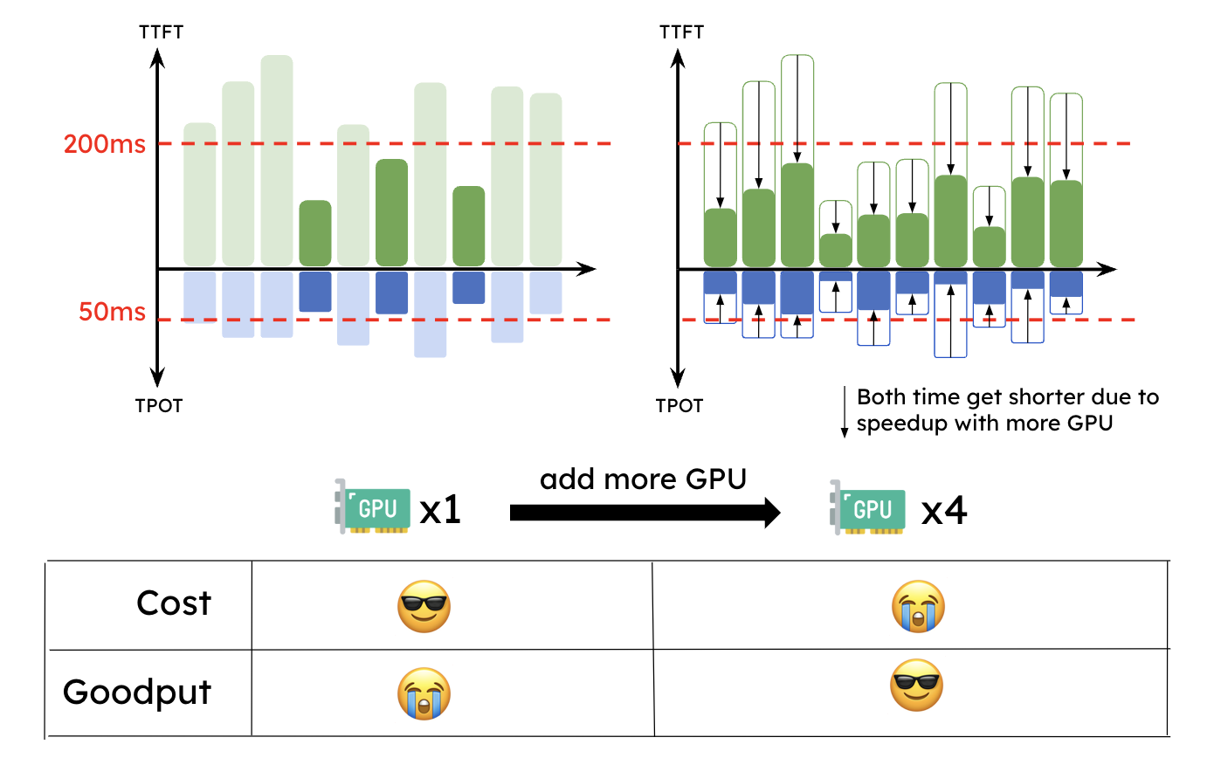
Motivation-Why disaggregate P & D?(3/4)
Because of the interference between P & D under colocation, resources need to be overprovisioned to meet SLOs

Slide 17
Motivation-Why disaggregate P & D?(4/4)
Colocation couples P & D’s resource allocation and parallelsim strategies
But due to their distinct computation patterns (P: compute-bound, D:memory-bound) and latency goals, the optimal parallelism strategy for the prefill and decoding phase is usually different.
Contradiction!
Notes:
Moreover, with colocation, the parallelism strategies (tensor, pipeline, or data parallelism) are inherently coupled for the prefill and decoding computation.
As discussed previously, due to their distinct computation patterns and latency goals, the optimal parallelism strategy for the prefill and decoding phase is usually different. For example, when TTFT is stringent and TPOT is loose, the prefill phase prefers tensor parallelism (TP) to meet the tight latency target while the decoding phase prefers data or pipeline parallelism to boost the throughput.
此外，通过并置，并行策略（张量、管道或数据并行）本质上是耦合的，用于预填充和解码计算。如前所述，由于其不同的计算模式和延迟目标，预填充和解码阶段的最佳并行策略通常是不同的。例如，当 TTFT 严格而 TPOT 宽松时，预填充阶段更喜欢张量并行（TP）以满足严格的延迟目标，而解码阶段更喜欢数据或管道并行以提高吞吐量。接下来我们将描述解决这些问题的新方法。

Slide 18
Outline
Introduction (4 min)
Preliminaries (10 min)
Analysis & Motivation (5 min)
Why disaggregate P & D?
Intuitive implementation of disaggregation
Tradeoff : transfer overhead vs throughput improvement
Proposed Methods (15 min)
Disaggregated architecures realizations
KV Cache Pool: distributed memory management
Scheduling
Performance Evaluation (15 min)
Discussions (5 min)
Q/A (5 min)
Notes:
so we know that until now, another factor, KV Cache transfer overhead, has been introduced to the whole system to participate the tradeoff
previous factors trading off each other include
1. computation (maybe of heterogeneous GPUs),
2. communication cost (this means inter-layer comm),
3. as well as memory
so in this section, we will introduce how disaggregation creates more opportunities for trading off and how the proposed methods reach a better performance under this disaggregation paradigm

Slide 19
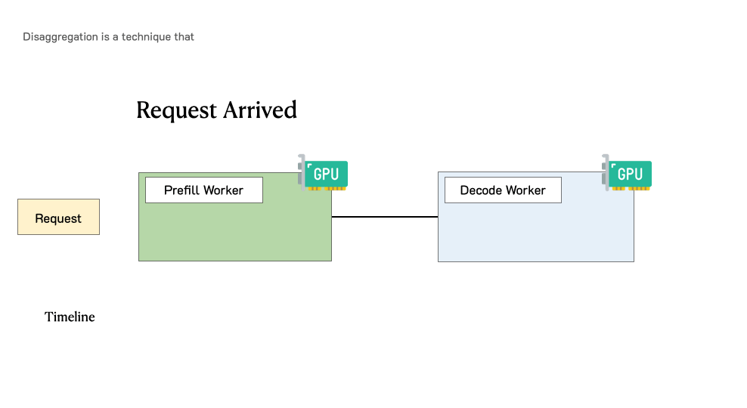
Motivation-Intuitive implementation of disaggregation
Introduces extra overhead of transfering KV Cache between GPUs for P & D
Notes:
The intuition is simple: disaggregating prefill and decode into different GPUs and customize parallelism strategies for each phase. This naturally solves the two problems above:
直觉很简单：将预填充和解码分解到不同的 GPU 中，并为每个阶段定制并行策略。这样自然就解决了上面两个问题：
No interference between prefill and decode makes both phases faster and easier to attain their respective SLO.
预填充和解码之间没有干扰，使两个阶段更快、更容易地达到各自的 SLO。
Decoupled resource allocation and parallelism strategy such that optimization can tailor for prefill and decode separately.
解耦资源分配和并行策略，以便优化可以分别针对预填充和解码进行定制。
Figure 5 illustrates how a request is processed in such a disaggregated system. When a request arrives in the system, it first goes to a prefill worker and completes its prefill phase. Then the system migrates its intermediate states (mainly KV Cache) to a decode worker, and multiple decode steps are taken to generate subsequent tokens. The request leaves the system once it finishes generation.
图 5 说明了如何在此类分解系统中处理请求。当请求到达系统时，它首先转到预填充工作人员并完成其预填充阶段。然后系统将其中间状态（主要是KV Cache ）迁移到解码工作器，并采取多个解码步骤来生成后续令牌。请求一旦完成生成就离开系统。

Slide 20
Outline
Introduction (4 min)
Preliminaries (10 min)
Analysis & Motivation (5 min)
Why Disaggregate P & D?
Intuitive Implementation of Disaggregation
Tradeoff : Transfer Overhead vs Throughput Improvement
Proposed Methods (15 min)
Disaggregated Architecures Realizations
KV Cache Pool: Distributed Memory Management
Scheduling
Performance Evaluation (15 min)
Discussions (5 min)
Q/A (5 min)
Notes:
so we know that until now, another factor, KV Cache transfer overhead, has been introduced to the whole system to participate the tradeoff
previous factors trading off each other include
1. computation (maybe of heterogeneous GPUs),
2. communication cost (this means inter-layer comm),
3. as well as memory
so in this section, we will introduce how disaggregation creates more opportunities for trading off and how the proposed methods reach a better performance under this disaggregation paradigm

Slide 21
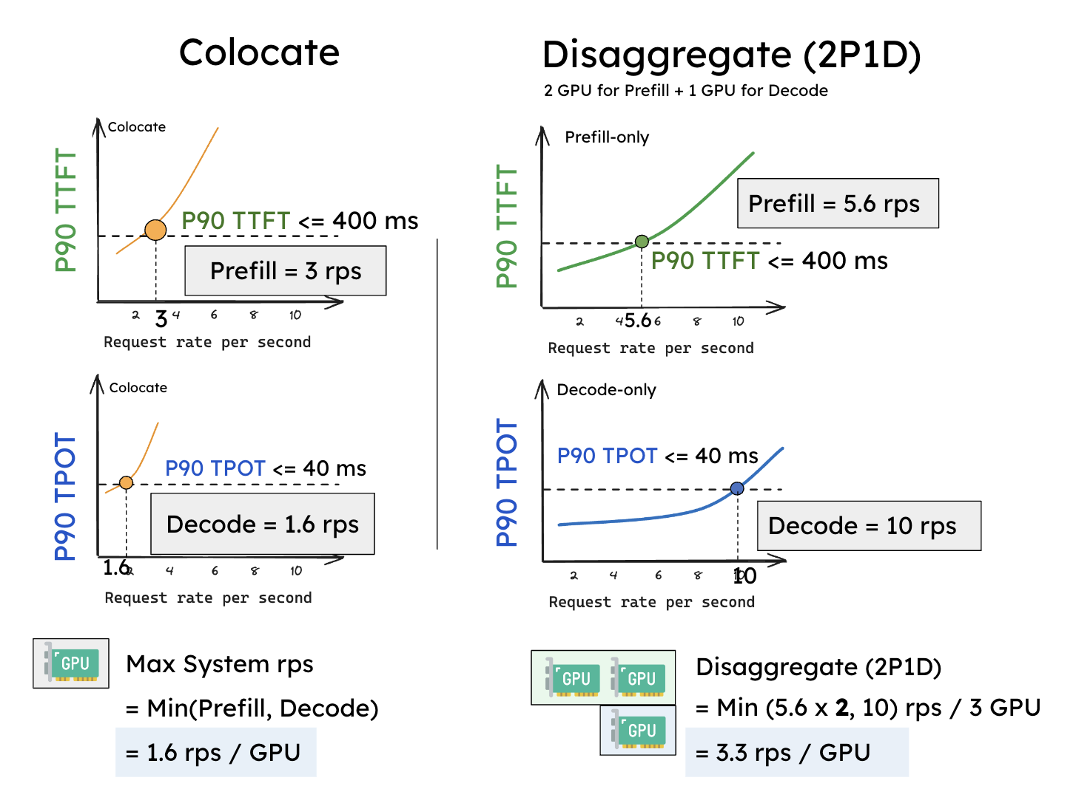
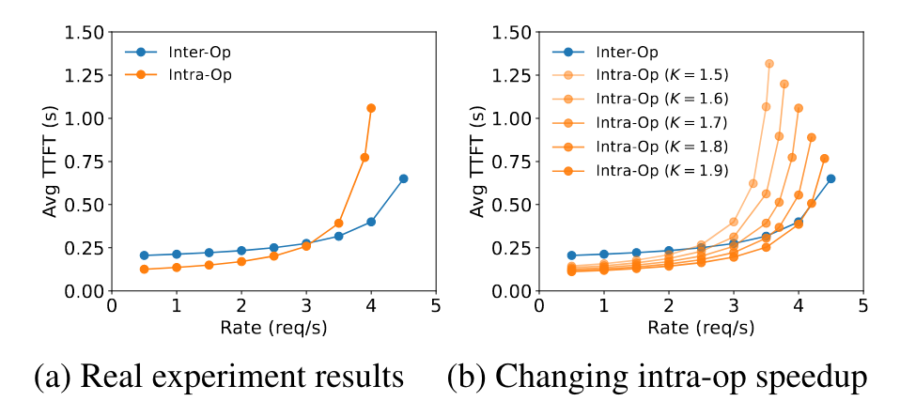
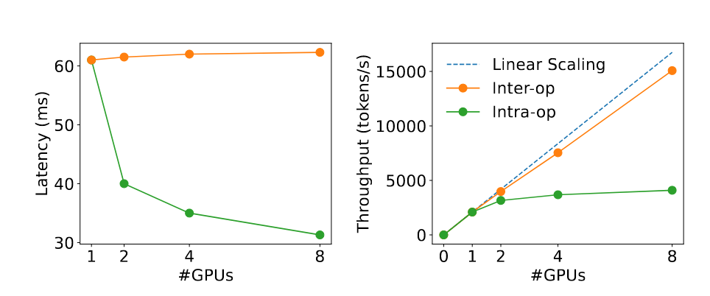
Tradeoff-Throughput improvement
1

Slide 22
Tradeoff-KV Cache transfer overhead
Acceptable if
Leverage high-speed networks: NVLink / PCI-e / IB
Under conditions that: with large models or long seqs
How to optimize throughput / request per $, but
minimize transfer overhead in this tradeoff?
Notes:
actually i quite doubt this part, i think decode isn’t decided by the seq_len

Slide 23
Outline
Introduction (4 min)
Preliminaries (10 min)
Analysis & Motivation (5 min)
Why Disaggregate P & D?
Intuitive Implementation of Disaggregation
Tradeoff : Transfer Overhead vs Throughput Improvement
Proposed Methods (15 min)
Disaggregated Architecures Realizations
KV Cache Pool: Distributed Memory Management
Scheduling
Performance Evaluation (15 min)
Discussions (5 min)
Q/A (5 min)
Notes:
so we know that until now, another factor, KV Cache transfer overhead, has been introduced to the whole system to participate the tradeoff
previous factors trading off each other include
1. computation (maybe of heterogeneous GPUs),
2. communication cost (this means inter-layer comm),
3. as well as memory
so in this section, we will introduce how disaggregation creates more opportunities for trading off and how the proposed methods reach a better performance under this disaggregation paradigm

Slide 24
Disaggregated Architecure Realizations

Slide 25
Tailored Parallelism for P & D (1/3)

Slide 26
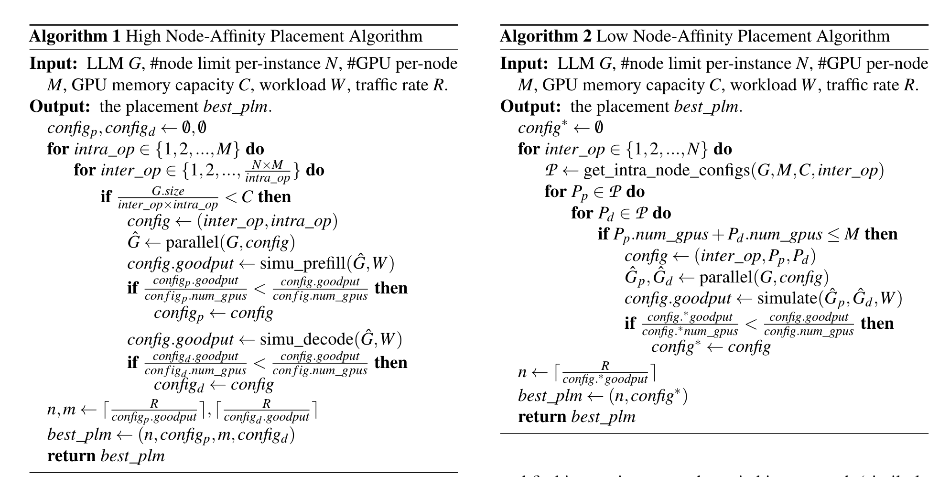
Tailored Parallelism for P & D (2/3)
DistServe: Finds a placement that maximizes the per-gpu goodput leveraging 2 placement algorithms
Notes:
present two placement algorithms: one for clusters with high-speed cross-node networks (§4.1) and the other for environments lacking such infrastructure (§4.2)
high node-affinity: 单机搜索：该算法主要搜索 TP、PP 并行度。给定现有的 GPU 数量等硬件资源，通过暴力搜索的方式搜索 TP、PP。对于每一个搜索的 TP、PP，运行一个模拟过程，得到在这个TP、PP 配置下 Prefill Worker、Decode Worker 每张卡的 Goodput，选择每个 Worker 最大化 Goodput 的 TP、PP 配置。
low node-affinity: 跨机搜索：当模型过大的时候，可能单机无法完全放下一个 Prefill Worker 和 Decode Worker。为了避免迁移开销上升，需要合理放置 Worker。
KVCache 按层存储，所以只要保证 Prefill 和 Decode Worker 相同层的 KVCache 在同一个机器内，KVCache 迁移就不会出现跨机传输。所以对于较大模型，可以把模型按层划分多段，每段放到不同机器，不同段的模型采用 PP，然后再对同一段的模型进行单机的模型并行策略的搜索。这样跨机传输仅出现在 PP 层间，不会出现在 KVCache 迁移，也保证了 KVCache 迁移开销始终低于 Decode 一个 tokens 的开销。

Slide 27
Tailored parallelism for P & D (3/3)
MoonCake: Chunked Pipeline Parallelism (CPP)
Implement a separate prefill node pool that seamlessly handles the dynamic distribution of context length
Scale the processing of a single request across multiple nodes, which is necessary for reducing the TTFT of long-context inputs.
Notes:
SP(Sequence Parallelism) still requires frequent cross-node communication, which lowers the MFU and competes with network resources for transferring KVCache across nodes
To address this, Mooncake leverages the autoregressive property of decoder-only transformers and implements chunked pipeline parallelism (CPP) for long context prefill. We group every X nodes in the prefill cluster into a pipelined prefill node group. For each request, its input tokens are partitioned into chunks, each no longer than the prefilled_chunk.Different chunks of the same request can be processed simultaneously by different nodes, thus parallelizing the processing and reducing TTFT.

Slide 28
KV Cache Pool

Slide 29
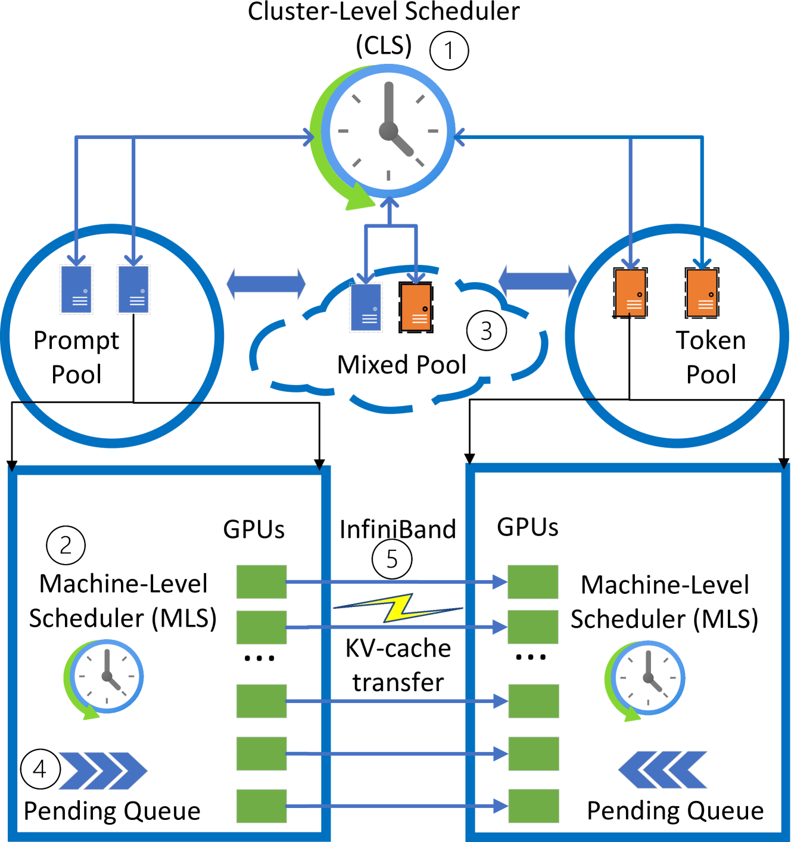
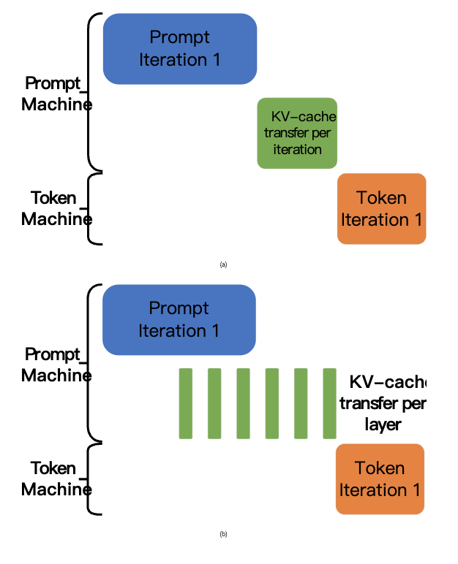
Distributed Memory Management(1/2)
SplitWise:
Prompt pool
Mixed pool
Token pool
Notes:
decode 机器不是去 prefill 机器取数据，prefill 机器也不是给 decode 送数据，不是个单纯的流水线的逻辑了，而是两者都是往 pool 里面写数据，decode 用的时候也是去 pool 里取数据（prefill 也会去取数据）。
In Splitwise, we optimize the KV-cache transfer by overlapping it with the computation in the prompt phase. As each layer in the LLM gets calculated in the prompt machine, the KV cache corresponding to that layer is also generated. At the end of each layer, we trigger an asynchronous transfer of the KV-cache for that layer while the prompt computation continues to the next layer.

Slide 30
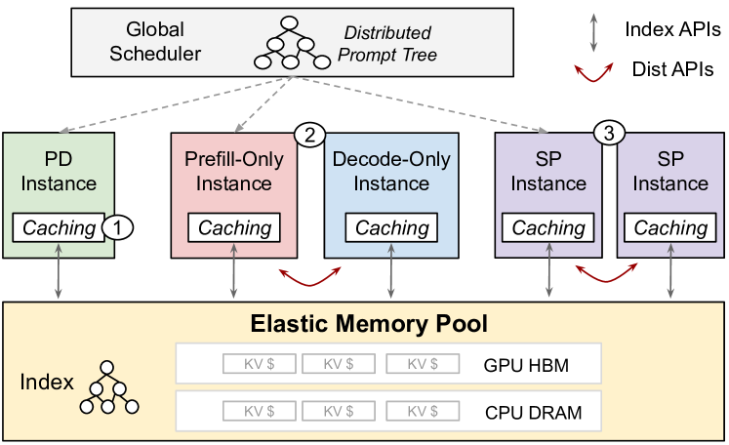
Distributed Memory Management(2/2)
MemServe
Elastic memory pool
Notes:
Use Cases Enabled By MemPool. Circle 1 is context caching. Circle 2 is disaggregated inference. Circle 3 is sequence parallelism. Solid gray lines mean MemPool index API calls. Solid red lines mean MemPool distributed APIs. MemPool enables all use cases in one platform.
To build context caching atop regular PD-colocated inference instances, one can use index APIs such as insert and match. To build disaggregated inference, one can call transfer API to send active KV cache from a prefill-only to a decode-only instance. To build sequence-parallel (SP) inference, one can use the transfer API to exchange attention outputs among instances, akin to InfiniteLLM (infiniteLLM,).
MemServe 看来是 memory server 的意思，实际上还是个简称 Memory-Enhanced Model Serving，主要是在分散推理的 setting 下引入了 MemPool，也就是一个弹性内存池，用于管理分布式内存和跨服务实例的 KVCache。当 KVCache 越来越大的时候，内存池中的布局就是一个非常大的问题，所以这里引入一个索引的机制，有了索引内存的检索就靠索引了，其实也就是给 pagedattention 中的 page 加一个 id，可以通过其他的检索机制来优化这个检索过程。本文中给出的就是 global prompt trees 的结构机制来进行优化。

Slide 31
Scheduling (1/5)

Slide 32
Scheduling (2/5)
DistServe:
FCFS
Notes:
DistServe operates with a simple FCFS scheduling policy. All incoming requests arrive at a centralized controller, then dispatched to the prefill instance with the shortest queue for prefill processing, followed by dispatch to the least loaded decoding instance for decoding steps. This setup, while simple, is optimized with several key enhancements tailored to the nuances of real-world workloads.
DistServe的运行时架构如图6所示。 DistServe 采用简单的 FCFS 调度策略运行。所有传入请求都到达集中控制器，然后分派到具有最短队列的预填充实例进行预填充处理，然后分派到负载最少的解码实例进行解码步骤。此设置虽然简单，但却针对实际工作负载的细微差别进行了多项关键增强功能的优化

Slide 33
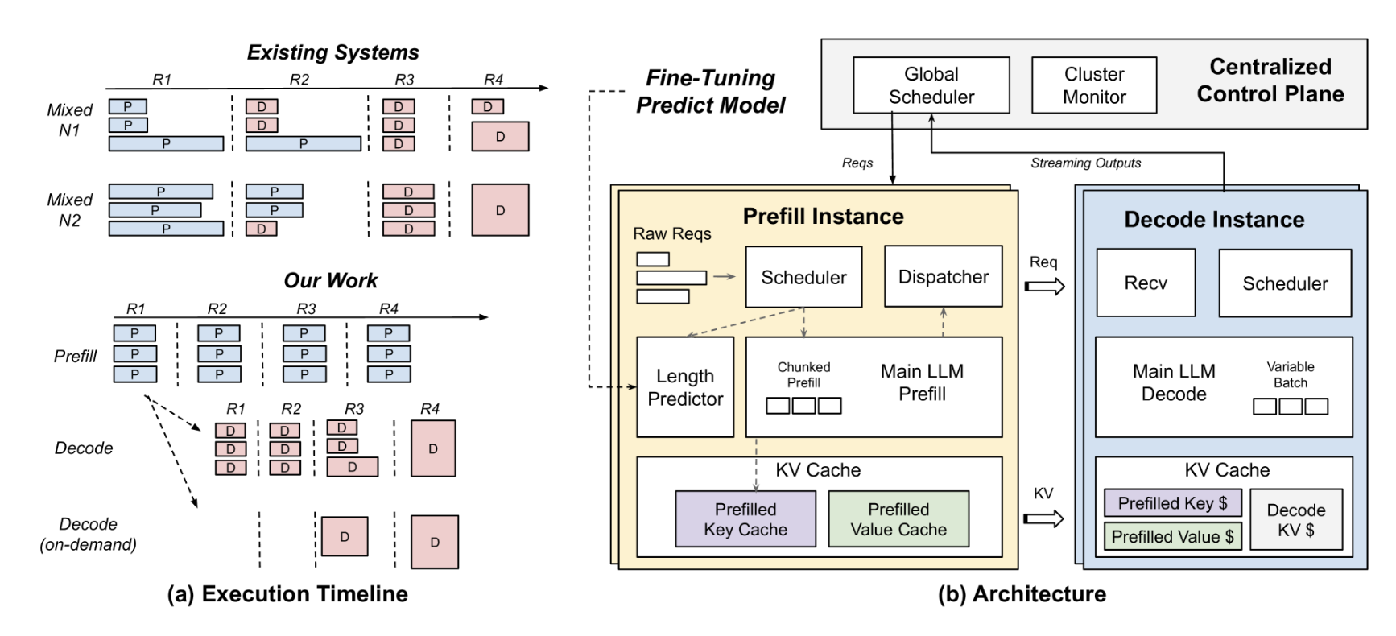
Scheduling (3/5)
TetriInfer:
Two-level scheduling
Notes:
uses a smart two-level scheduling algorithm augmented with predicted resource usage to avoid decode scheduling hotspots.
Under the reserve-static policy, a request is scheduled only if its predicted memory usage is smaller than the available accelerator memory for the current iteration. 在保留静态策略下，仅当预测的内存使用量小于当前迭代的可用加速器内存时，才会调度请求。
调度 decode 阶段任务避免调度热点(hot spot)，主要是基于输出的长度预测

Slide 34
Scheduling (4/5)
SplitWise: A hierarchical two-level scheduling
CLS
MLS
Notes:
The cluster-level scheduler (CLS)
1
is responsible for machine pool management and for routing incoming inference requests. The machine-level scheduler (MLS)
2
maintains the pending queue and manages batching of requests at each machine.

Slide 35
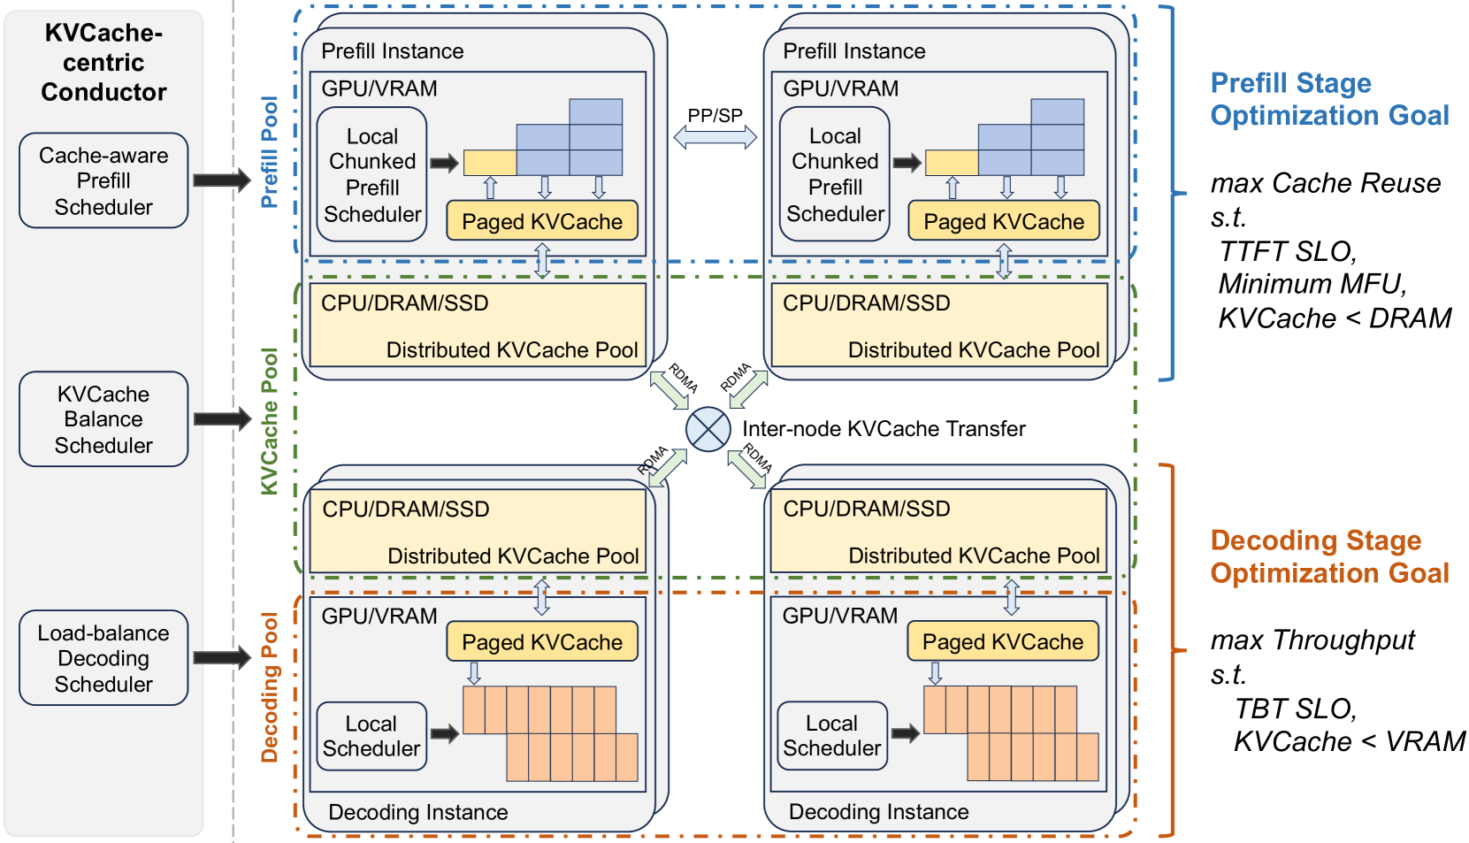
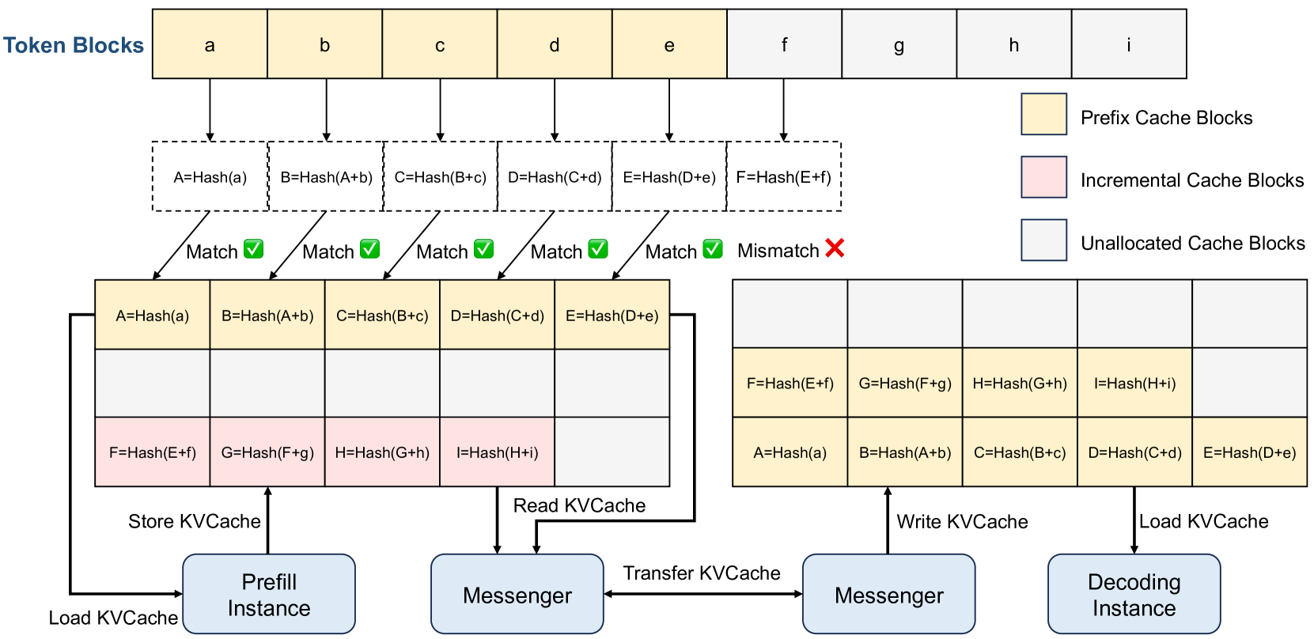
Scheduling (5/5)
MoonCake: KVCache-centric scheduling & Overload-oriented scheduling
Notes:
这一章开始讲调度了。
KVCache Pool用Paged方式管理KVCache（本章简称Cache）。如下图所示，黄色是已经有的Prefix Cache Blocks，其他request算了，本request可以复用。粉色是本request自己算的Incremental Cache Blocks。这Pool也会用一些Cache策略来新陈代谢，比如LRU、LFU之类的。
Prefill节点接收到一个request，它根据prefix cache ID将前prefix cache从远程CPU内存加载到本地GPU内存，以启动request的prefill计算。如果不存在prefix cache，则需要自己Prefill计算了。这种选择平衡了三个目标：尽可能多地重用KVCache（三板斧中Caching）、平衡不同预填充节点的工作负载，并保证TTFT SLO（三板斧中Scheduling）。
第二个：early rejection policy: 现有的LLM服务通常假设所有请求都会被处理，并根据请求吞吐量、TTFT和TBT进行优化。然而，处理每个请求既不经济也不现实，尤其是在请求激增时，集群资源增长跟不上请求增长，导致过载。为了平衡成本和用户体验，系统应在负载达到阈值前尽可能处理请求，之后拒绝或推迟剩余请求。

Slide 36
Outline
Introduction (4 min)
Preliminaries (10 min)
Analysis & Motivation (5 min)
Why Disaggregate P & D?
Intuitive Implementation of Disaggregation
Tradeoff : Transfer Overhead vs Throughput Improvement
Proposed Methods (15 min)
Disaggregated Architecures Realizations
KV Cache Pool: Distributed Memory Management
Scheduling
Performance Evaluation (15 min)
Discussions (5 min)
Q/A (5 min)
Notes:
so we know that until now, another factor, KV Cache transfer overhead, has been introduced to the whole system to participate the tradeoff
previous factors trading off each other include
1. computation (maybe of heterogeneous GPUs),
2. communication cost (this means inter-layer comm),
3. as well as memory
so in this section, we will introduce how disaggregation creates more opportunities for trading off and how the proposed methods reach a better performance under this disaggregation paradigm

Slide 37
Evaluation-performance metrics
End-to-end (E2E) latency
Service level objectives (SLOs)
Time To First Token (TTFT)
Time Per Output Token (TPOT)
Time Between Tokens (TBT) (SplitWise)
Job Completion Time (JCT)
Throughput
Goodput (DistServe)

Slide 38
Evaluation-DistServe
Notes:
Chatbot. We evaluate the performance of DistServe on the chatbot application for all three OPT models. The first row of Figure 8 illustrates that when we gradually increase the rate, more requests will violate the latency requirements and the SLO attainment decreases. The vertical line shows the maximum per-GPU rate the system can handle to meet latency requirements for over 90% of the requests.
聊天机器人。我们评估了 DistServe 在所有三种 OPT 模型的聊天机器人应用程序上的性能。图8的第一行说明，当我们逐渐提高速率时，更多请求将违反延迟要求，并且 SLO 达到率会降低。垂直线显示系统可以处理的最大每 GPU 速率，以满足超过 90% 的请求的延迟要求。
The second row of Figure 8 indicates the robustness to the changing latency requirements of the two systems. We fix the rate and then linearly scale the two latency requirements in Table 1 simultaneously using a parameter called SLO Scale. As SLO Scale decreases, the latency requirement is more stringent. We aim to observe the most stringent SLO Scale that the system can withstand while still achieving the attainment target.
Figure 8 shows that DistServe can achieve 1.8×–3.2×more stringent SLO than vLLM and 1.7×–1.8×more stringent SLO than DeepSpeed-MII, thus providing more engaging service quality to the users.
图8的第二行表明了两个系统对不断变化的延迟要求的稳健性。我们固定速率，然后使用称为SLO Scale 的参数同时线性缩放表1中的两个延迟要求。随着 SLO 规模的减小，延迟要求更加严格。我们的目标是遵守系统能够承受的最严格的 SLO 等级，同时仍能实现目标。有更严格的 SLO，从而为用户提供更具吸引力的服务质量。

Slide 39
Evaluation-TetriInfer
Notes:
it shows that on different workloads of prefill and decoding, TetriInfer uses less time than vLLM

Slide 40
Evaluation-MoonCake
Notes:
it shows that MoonCake has lower TTFT and better throughput compared to vLLM
The results, depicted in Figure 11, demonstrate that on the ArXiv Summarization and L-Eval datasets, Mooncake-[3P+1D] achieves throughput improvements of 20% and 40%, respectively, over vLLM-[4M] while satisfying SLOs. Moreover, Mooncake’s throughput on the L-Eval dataset is further enhanced by prefix caching, which significantly reduces prefill time. However, despite having lower TBT latency, Mooncake-[2P+2D] does not perform as well on the TTFT metric compared to Mooncake-[3P+1D] and vLLM-[4M]. This discrepancy arises from an imbalance in the load between prefill and decoding instances. In real-world clusters, the demand for prefill and decoding instances generally remains stable over certain periods, with only minor temporary imbalances. Thus, the proportion of prefill and decoding instances can be preset. Future research will explore more flexible deployment and conversion methods.

Slide 41
Conclusions
PD disaggregation enhances resource utilization and satisfies SLO at lower cost
PD disaggregation decouples resource allocation and parallelsim strategies such that optimization can tailor for P and D separately.
After disaggregationg, it turns into a conventional distributed system problem, thus we use scheduling, batching and caching to further optimize.

Slide 42
Outline
Introduction (4 min)
Preliminaries (10 min)
Analysis & Motivation (5 min)
Why Disaggregate P & D?
Intuitive Implementation of Disaggregation
Tradeoff : Transfer Overhead vs Throughput Improvement
Proposed Methods (15 min)
Disaggregated Architecures Realizations
KV Cache Pool: Distributed Memory Management
Scheduling
Performance Evaluation (15 min)
Discussions (5 min)
Q/A (5 min)
Notes:
so we know that until now, another factor, KV Cache transfer overhead, has been introduced to the whole system to participate the tradeoff
previous factors trading off each other include
1. computation (maybe of heterogeneous GPUs),
2. communication cost (this means inter-layer comm),
3. as well as memory
so in this section, we will introduce how disaggregation creates more opportunities for trading off and how the proposed methods reach a better performance under this disaggregation paradigm

Slide 43
Discussions (1/2)
What level of disaggregation is preferable?
PD on the same GPU
PD on same GPU but scheduled separately
PD on diffferent GPUs on the same node (isomorphitc net, isomorphitc computing resources)
PD on diffferent GPUs on different node (isomorphitc net, heteorgeneous computing resources)
PD on diffferent GPUs on different nodes in different clusters (heteorgeneous net, heteorgeneous computing resources)

Slide 44
Discussions (2/2)
Is it necessary to disagg P & D on heterogeneous resources?
Cons:
Overhead for inter-node communication
Heterogeneous GPUs may cause fragmentation
Pros:
Relieve memory congestion (esp. Large models / long context)
Tailored parallelism for P & D, thus higher throughput
Reduce cost (enhance request per $), use cheap GPU for decoding
My comments:
Heterogeneous GPU cluster would be a trend as long as sale restriction sustains, thus leveraging heterogeneous resources to do PD disaggregation will be a must.

Slide 45
Outline
Introduction (4 min)
Preliminaries (10 min)
Analysis & Motivation (5 min)
Why Disaggregate P & D?
Intuitive Implementation of Disaggregation
Tradeoff : Transfer Overhead vs Throughput Improvement
Proposed Methods (15 min)
Disaggregated Architecures Realizations
KV Cache Pool: Distributed Memory Management
Scheduling
Performance Evaluation (15 min)
Discussions (5 min)
Q/A (5 min)
Notes:
so we know that until now, another factor, KV Cache transfer overhead, has been introduced to the whole system to participate the tradeoff
previous factors trading off each other include
1. computation (maybe of heterogeneous GPUs),
2. communication cost (this means inter-layer comm),
3. as well as memory
so in this section, we will introduce how disaggregation creates more opportunities for trading off and how the proposed methods reach a better performance under this disaggregation paradigm

