Slide 1
Hybird Accelerator for GCN Inference 2024.11.21
Liangsen Wang
School of Data Science
Chinese University of Hong Kong, Shenzhen

Slide 2
Outline
Introduction (3 min)
Background & Motivation (5 min)
Proposed Methods & Evaluation (30 min)
HyGCN (10 min)
Downstream Task Based Design (10 min)
GPGCN (10 min)
Conclusions (2 min)
Q/A (5 min)

Slide 3
Outline
Introduction (3 min)
Background & Motivation (5 min)
Proposed Methods & Evaluation (30 min)
HyGCN (10 min)
Downstream Task Based Design (10 min)
GPGCN (10 min)
Conclusions (2 min)
Q/A (5 min)

Slide 4
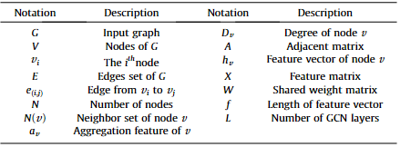
Introduction (1/2)
What is GCN?
An effective category of models to represent and process graph data
GCN structure

Slide 5
Introduction (2/2)
Wide Application of GCN
social networks, particle physics, knowledge graphs, drug discovery……
Scalability and Performance Challenges
The distinct features of the two phases
Random and sparse structure of graphs
Dynamic and random memory access
The difficulty of data reuse
Inefficient on existing architecture
……

Slide 6
Outline
Introduction (3 min)
Background & Motivation (5 min)
Proposed Methods & Evaluation (30 min)
HyGCN (10 min)
Downstream Task Based Design (10 min)
GPGCN (10 min)
Conclusions (2 min)
Q/A (5 min)

Slide 7
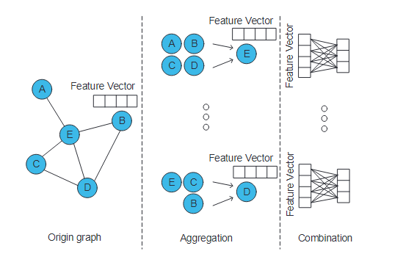
Background & Motivation (1/8)
Bottleneck of GCN Inference
The convolutional layers occupy the major execution time of GCNs through two primary execution phases: Aggregation and Combination

Slide 8
Background & Motivation (2/8)
Sparseness
Load Imbalance
The different nodes of a graph have extremely different numbers of neighbor nodes

Slide 9
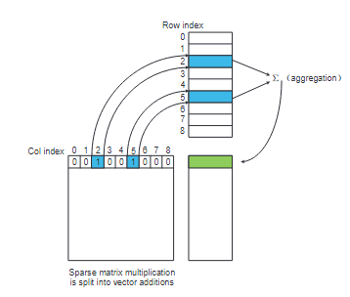
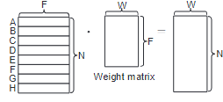
Background & Motivation (3/8)
Different Computational Models in Two Phases
Aggregation
Combination

Slide 10
Background & Motivation (4/8)
Different Computational Models in Two Phases
Aggregation
Combination

Slide 11
Background & Motivation (5/8)
Different Computational Models in Two Phases

Slide 12
Background & Motivation (6/8)
Different Computational Models in Two Phases

Slide 13
Background & Motivation (7/8)
Differences from Conventional Workloads
Length of feature vectors is variable
Feature vectors usually orders of magnitude longer
MLP parameters are fully shared by all vertices

Slide 14
Background & Motivation (8/8)
Inefficiencies of General-Purpose Processors
CPUs
GPUs
Irregularity in aggregation phase unfriendly to current cache and data prefetching techniques
Hard to reuse the highly reusable data between compute units.
Inherently optimized for compute-intensive workloads with regular execution pattern
Combination with strong parameter sharing needs costly data copy and thread synchronization
Both lack inter-phase optimization due to phase-by-phase execution

Slide 15
Outline
Introduction (3 min)
Background & Motivation (5 min)
Proposed Methods & Evaluation (30 min)
HyGCN (10 min)
Downstream Task Based Design (10 min)
GPGCN (10 min)
Conclusions (2 min)
Q/A (5 min)

Slide 16
Outline
Introduction (3 min)
Background & Motivation (5 min)
Proposed Methods & Evaluation (30 min)
HyGCN (10 min)
Downstream Task Based Design (10 min)
GPGCN (10 min)
Conclusions (2 min)
Q/A (5 min)

Slide 17
HyGCN (1/11)
Overall Hardware Architecture

Slide 18
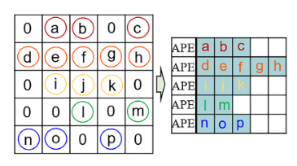
HyGCN (2/11)
Aggregation Engine —— PE Model
Two Model of Parallel
Vertex-Concentrated

Slide 19
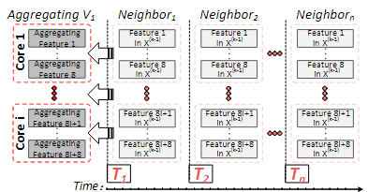
HyGCN (3/11)
Aggregation Engine —— PE Model
Two Model of Parallel
Intra-Vertex

Slide 20
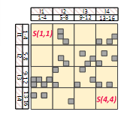
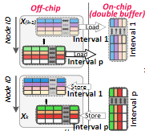
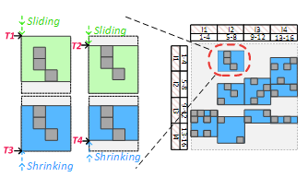
HyGCN (4/11)
Aggregation Engine —— Sparsity Elimination

Slide 21
HyGCN (5/11)
Combination Engine —— PE Model
Different Use of Systolic Array
Independent
VS
Cooperative

Slide 22
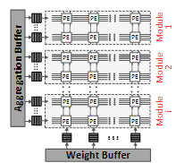
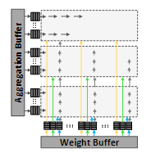
HyGCN (6/11)
Combination Engine —— PE Model
Different Use of Systolic Array
Independent
VS
Cooperative

Slide 23
HyGCN (7/11)
Inter-Engine Optimization
Latency-Aware
Energy-Aware

Slide 24
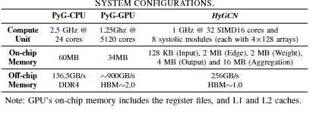
HyGCN (8/11)
Evaluation Results

Slide 25
HyGCN (9/11)
Evaluation Results
Algorithm Optimization
CPU
GPU

Slide 26
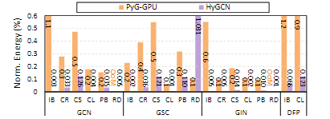
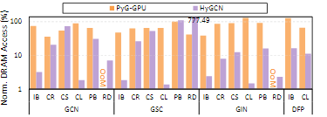
HyGCN (10/11)
Evaluation Results

Slide 27
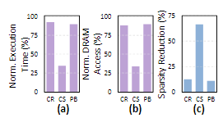
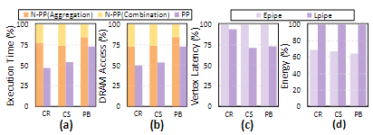
HyGCN (11/11)
Evaluation Results

Slide 28
Outline
Introduction (3 min)
Background & Motivation (5 min)
Proposed Methods & Evaluation (30 min)
HyGCN (10 min)
Downstream Task Based Design (10 min)
GPGCN (10 min)
Conclusions (2 min)
Q/A (5 min)

Slide 29
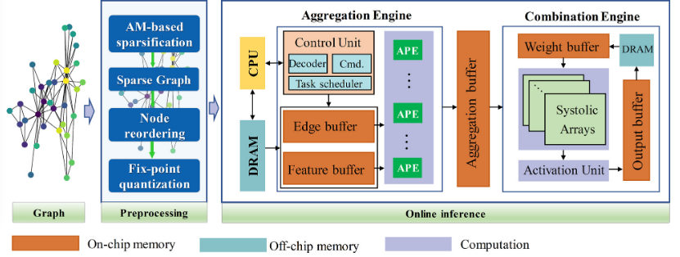
Downstream Task Based Design (1/8)
Overview Framework

Slide 30
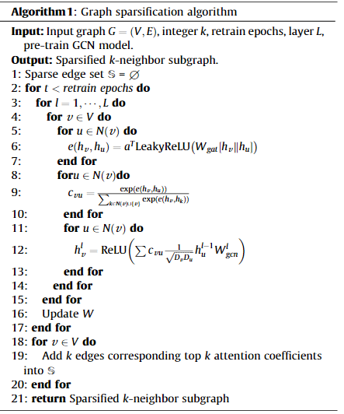
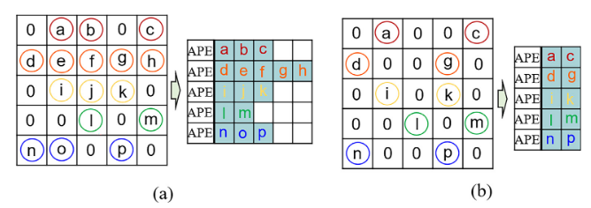
Downstream Task Based Design (2/8)
Graph Sparsification
From the hardware perspective, in the aggregation phase, the memory traffic is relevant to the number of edges
Prune redundant edges to achieve graph sparsification
Attention-mechanism based graph sparsification

Slide 31
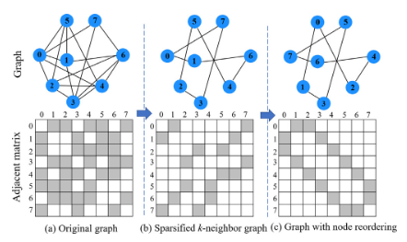
Downstream Task Based Design (3/8)
Node Reorder
Fixed-Point Quantization

Slide 32
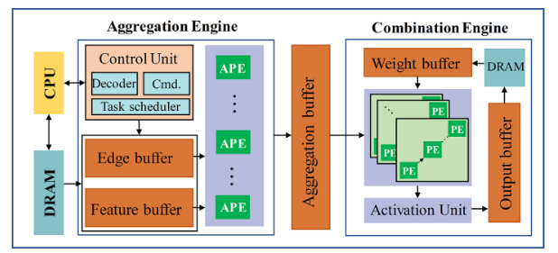
Downstream Task Based Design (4/8)
Hardware Arichitecture

Slide 33
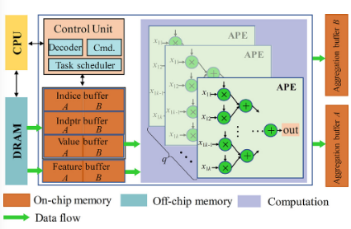
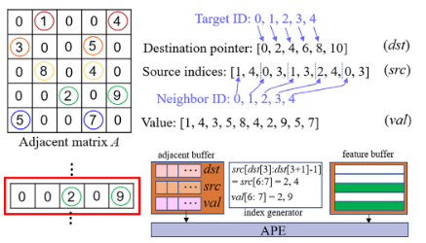
Downstream Task Based Design (5/8)
Hardware Arichitecture —— Aggreation Engine
Graph Partition and Feature Tiling
Data Storage and Access

Slide 34
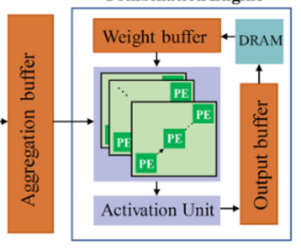
Downstream Task Based Design (6/8)
Hardware Arichitecture —— Combination Engine
Systolic Arrays

Slide 35
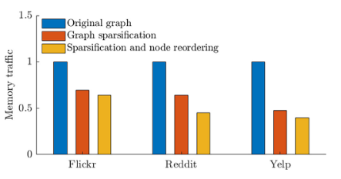
Downstream Task Based Design (7/8)
Evaluation Results

Slide 36
Downstream Task Based Design (8/8)
Evaluation Results

Slide 37
Outline
Introduction (3 min)
Background & Motivation (5 min)
Proposed Methods & Evaluation (30 min)
HyGCN (10 min)
Downstream Task Based Design (10 min)
GPGCN (10 min)
Conclusions (2 min)
Q/A (5 min)

Slide 38
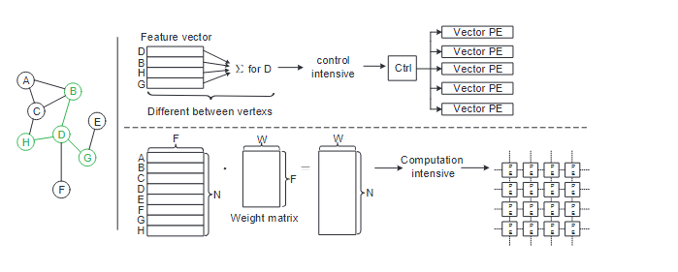
GPGCN (1/17)
Control Intensive
Computational Intensive

Slide 39
GPGCN (2/17)
RISC-V Extension
Custom CSR
Encode many pieces of instruction operation information required in the limited RISC instruction encoding space
Provide some common information between instructions through the custom CSR (current status registers) registers to solve and reduce instruction coding pressure

Slide 40
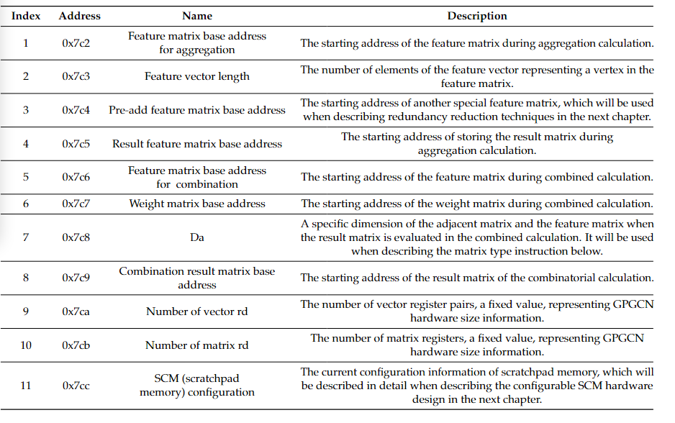
GPGCN (3/17)
Custom CSR

Slide 41
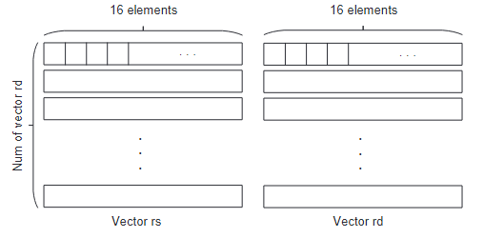
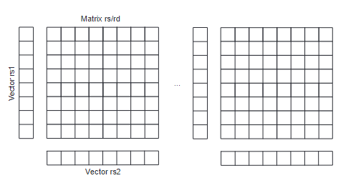
GPGCN (4/17)
Register Extension
Vector Register Group
9th CSR——Number of vector register pairs
Contains 1 rs register and 1 rd register
16 32-bit single-precision floating-point elements
Matrix Register Group
10th CSR ——Number of matrix registers pairs
Contains 2 vector rs registers, 1 matrix rs register, and 1 matrix rd register
To support outer product operations, rs register contains 8 32-bit single-precision float point elements

Slide 42
GPGCN (5/17)
Basic Vector Instructions
Similar to the traditional SIMD instruction
load/store address = base_address(CSR1) + idx ∗vector_length(CSR2)

Slide 43
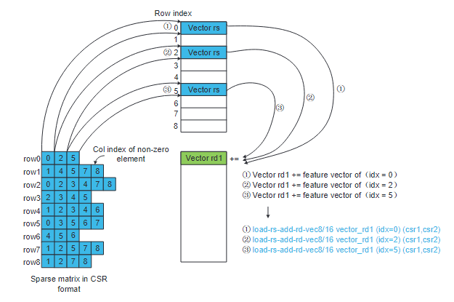
GPGCN (6/17)
Fixed-Rd Vector Instructions
Fixed vector rd is for multiplexing data (aggregated intermediate results) in vector rd.

Slide 44
GPGCN (7/17)
Fixed-Rd Vector Instructions
Data in vector rd register are multiplexed. In contrast, data in vector rs register are not multiplexed
Saves encoding space to fuse the loadvec instruction and the addvec instruction
More macro, increasing the instruction information density, instruction bandwidth is improved.

Slide 45
GPGCN (8/17)
Fixed-Rd Vector Instructions
No need to specify the index of the vector rs register
Vector rd is bound to the corresponding vector rs

Slide 46
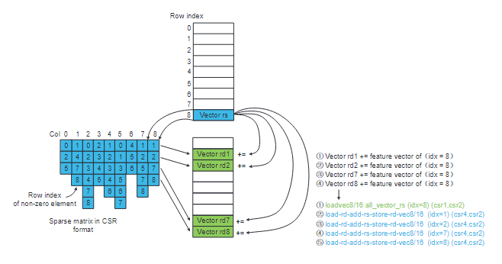
GPGCN (9/17)
Fixed-Rs Vector Instructions

Slide 47
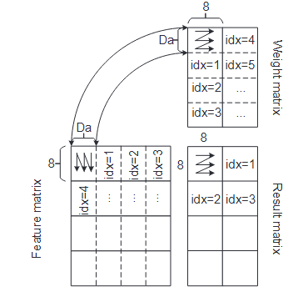
GPGCN (10/17)
Matrix Instruction Extension
Da is specified by custom CSR7
In order to further increase the instruction density of the matrix instructions, the matrix multiplication operation of 8 × Da × Da × 8 = 8 × 8

Slide 48
GPGCN (11/17)
Matrix Instruction Extension

Slide 49
GPGCN (12/17)
Memory Access Extension
The preload instruction preloads the feature matrix or weight matrix we want to access to the corresponding storage block of the scratchpad memory in advance
The sync-preload instruction is used to indicate that the data in a block of scratchpad memory are no longer used and can be replaced
The storescmback instruction is used to write a block of scratchpad memory back to the main memory. For example, after the fixed-rs instructions calculate the final result, the final result in scratchpad memory is written back to the main memory

Slide 50
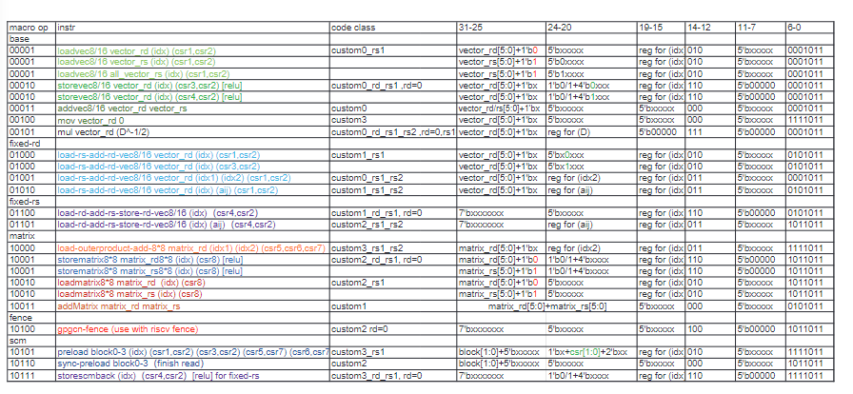
GPGCN (13/17)
RISC-V Extension

Slide 51
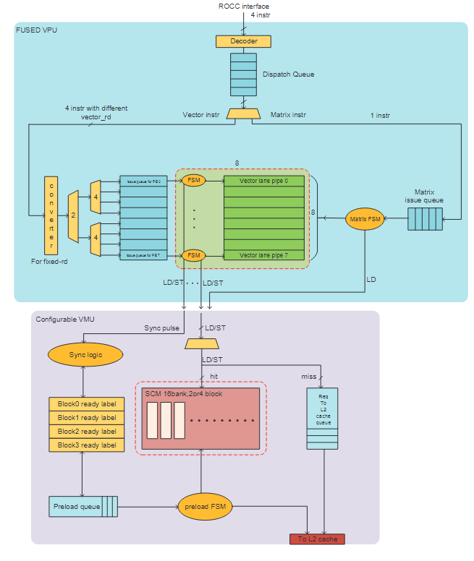
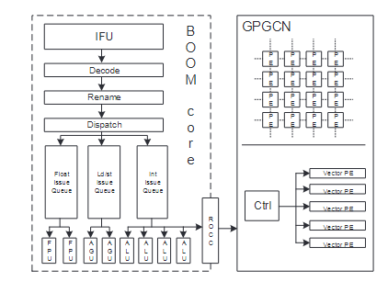
GPGCN (14/17)
Hardware Architecture
fused VPU (vector process unit)
vector instructions
matrix instructions
configurable VMU (vector memory unit)

Slide 52
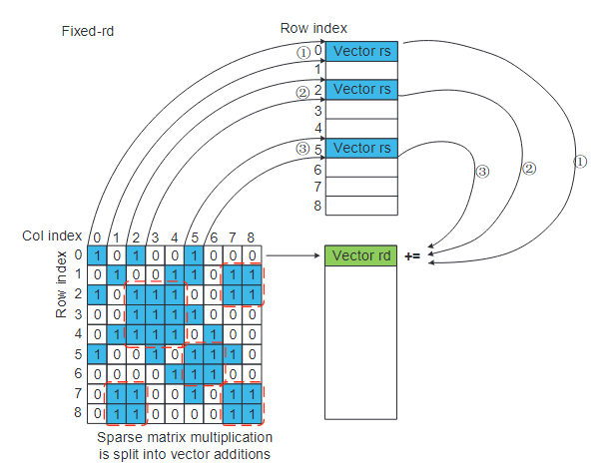
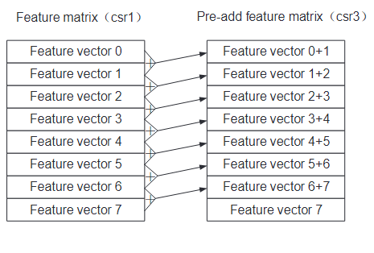
GPGCN (15/17)
Redundant Computation Reduction

Slide 53
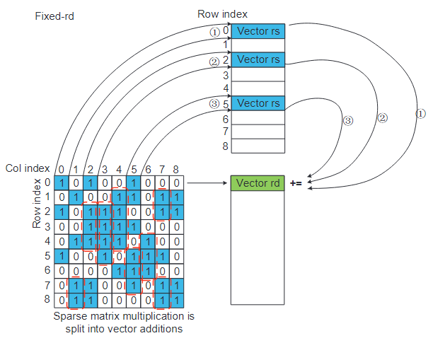
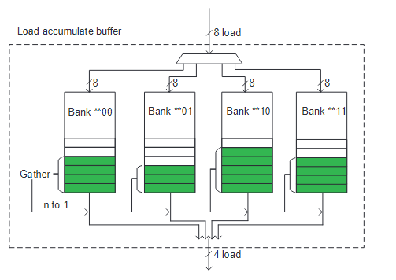
GPGCN (16/17)
Memory Access Optimization

Slide 54
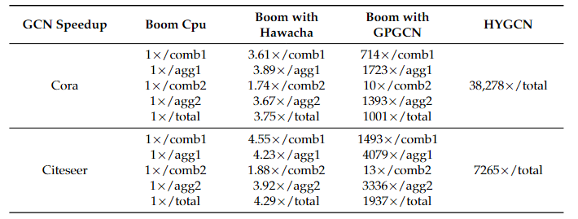
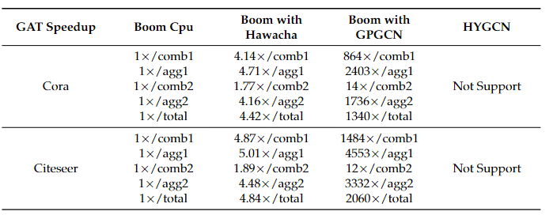
GPGCN (17/17)
Evaluation Results

Slide 55
Outline
Introduction (3 min)
Background & Motivation (5 min)
Proposed Methods & Evaluation (30 min)
HyGCN (10 min)
Downstream Task Based Design (10 min)
GPGCN (10 min)
Conclusions (2 min)
Q/A (5 min)

Slide 56
Conclusions
Based on the characteristics of GCN, a hybrid structure accelerator was designed
This talk showcases three existing hybrid GCN accelerators.
HyGCN
Downstream Task Based Design
GPGCN

Slide 57
Outline
Introduction (3 min)
Background & Motivation (5 min)
Proposed Methods & Evaluation (30 min)
HyGCN (10 min)
Downstream Task Based Design (10 min)
GPGCN (10 min)
Conclusions (2 min)
Q/A (5 min)

